Slide 1



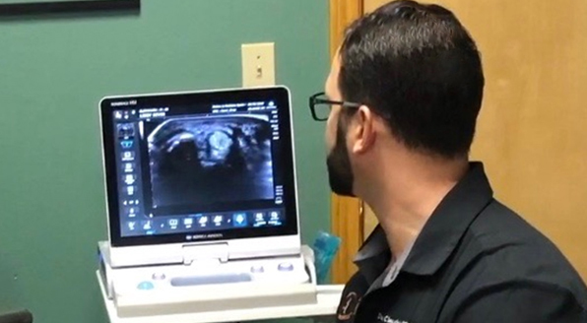
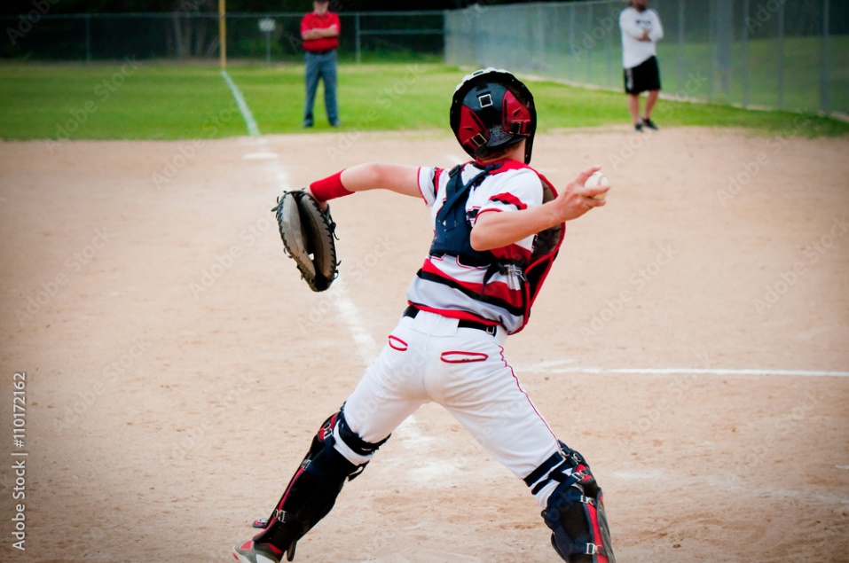
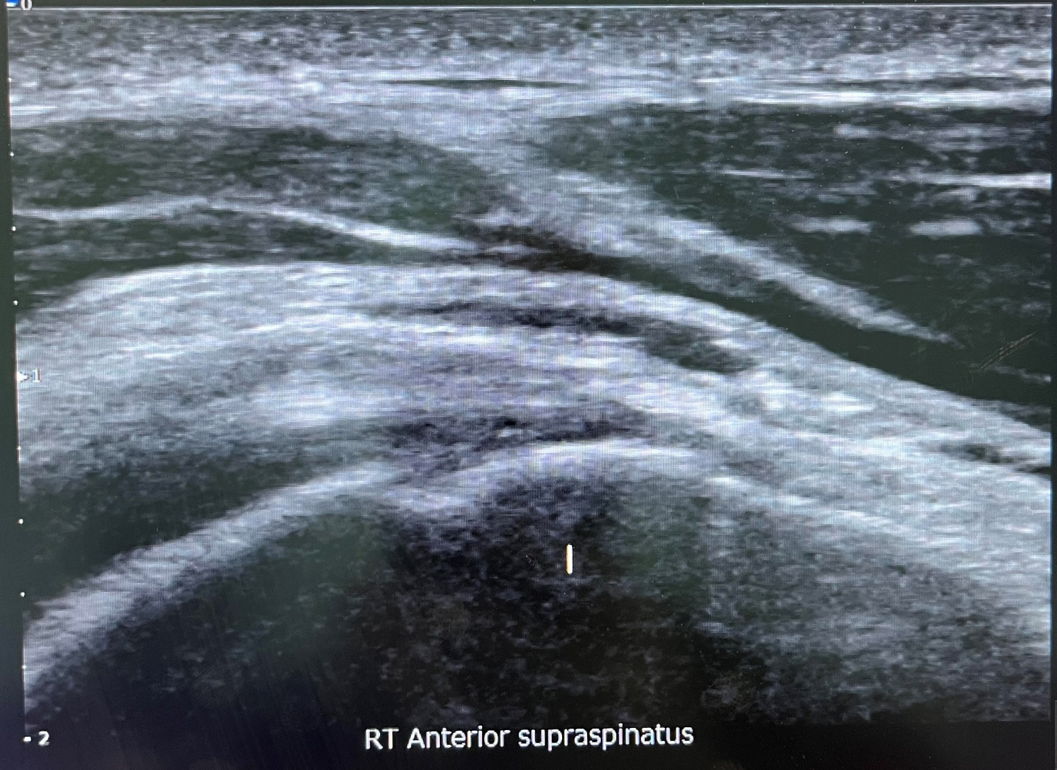
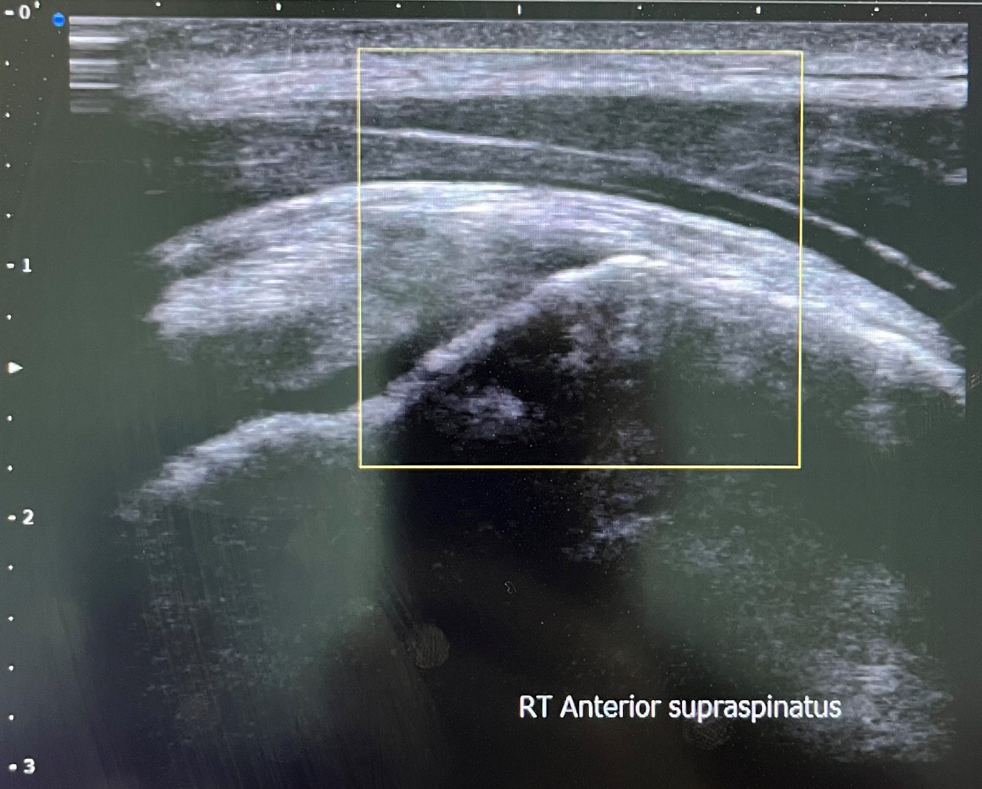
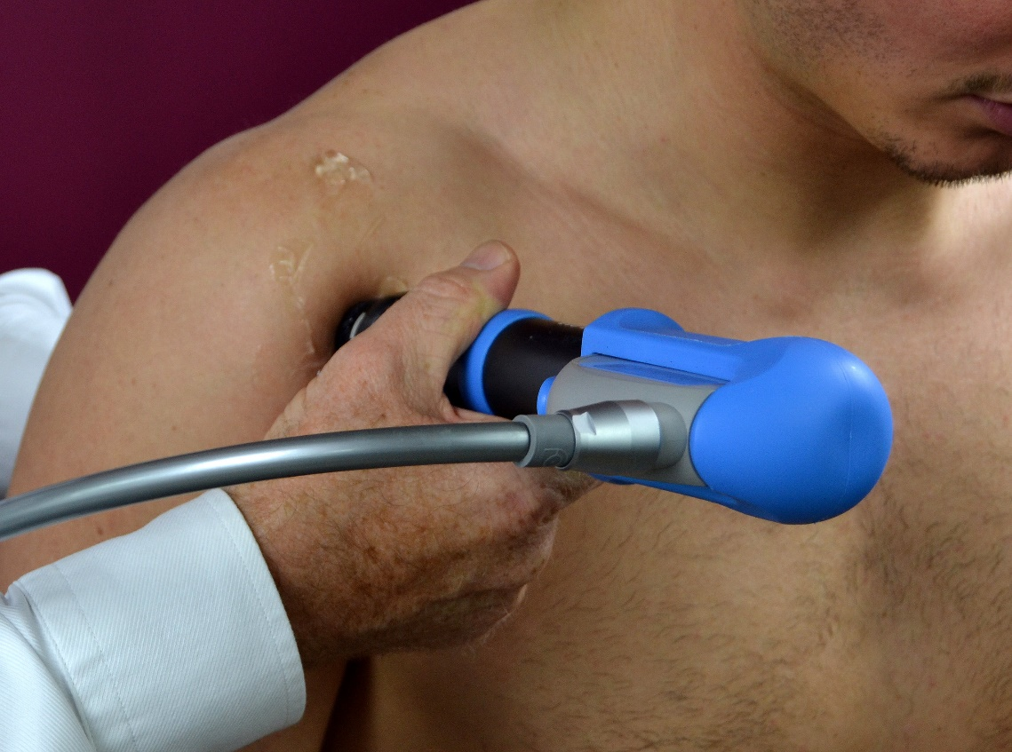
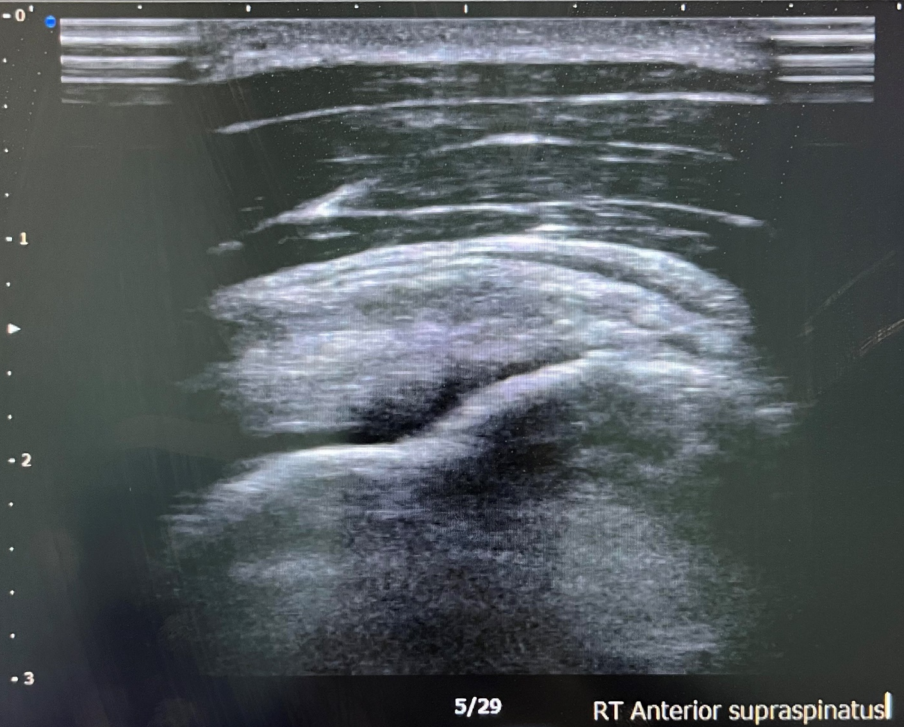
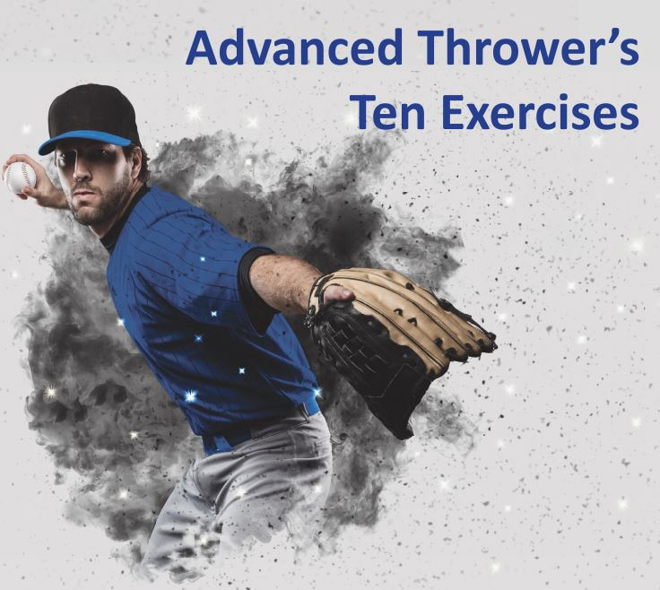
Utilization of Platelet Releasate for Faster Return-To-Play in a High School Baseball Athlete with a Partial Rotator Cuff Tear
Jason Taporco, MD, MPH; Daniel Clearfield, DO, MS, FAOASM
Abstract
Timeline
Discussion & Conclusion
Partial thickness supraspinatus tears are a common injury amongst athletes. There is no current consensus on treatment of these injuries, though regenerative treatments have gained traction in recent years. Due to the debilitating nature of these injuries, there is a great need for treatments that improve outcomes and improve return-to-play times.
In this case study, we demonstrate an ultrasound-proven 60% improvement in supraspinatus tear width 4 weeks after administration of platelet releasate, shockwave therapy, and rehabilitation exercises.
Utilization of platelet releasate in combination with ESWT, prolotherapy, and rehabilitation led to dramatic improvement of a partial-thickness supraspinatus tear and decreased return-to-play time to four weeks in a high school baseball athlete.
Protocols
Platelet Releasate Injection
90 cc of whole blood drawn and spun down to 10cc PRP
Addition of 0.9cc Prothrombin
  Centrifuged at 3000 RPM for 8 minutes
  Plasma siphoned and passed through 0.2 μm filter
Combined with 0.5cc ropivicaine and injected into SS and SAB under US guidance
Counseled to avoid NSAIDs x14 days.
Prolotherapy
5 cc of D25 utilizing a 22g 2.75” needle
Extracorporeal Shockwave Therapy
Series of 4 treatments over 4 weeks
D-Actor C15 tip @ 15MHz for 3000 total pulse sutilizing 2.6-3.6 bars of energy.
March ’22 – Initial Injury
Injury to throwing arm diagnosed as rotator cuff tear vs. tendinitis. Treated with rest and RAMG, but unable to RTP that season. Was able to participate in summer season.
January ‘23 – First Medical Contact
MSKUS remarkable for 25% partial tear of the supraspinatus on the bursal surface at the RTC interval anteriorly. Discussed options, patient elected for Prolotherapy, Platelet Releasate, ESWT x4.
December ’22 – Re-Injury
Aggravated injury. Notes sharp anterior shoulder pain during cocking phase of throwing. Attempted rest and STIM, but pain persisted.
February ‘23 – 4-Weeks Post-Injection
Repeat MSKUS showed dramatic improvement with a 10% tear remaining, new evidence of acute supraspinatus tendinitis and subacromial bursitis.
February ‘23 – Return to Play
Patient reported 25% improvement of symptoms, given meloxicam PRN. Released with PRICEMM, RAMG, HEP, PT. Patient hit a game-winning homerun on his return.
Interventions
Musculoskeletal Ultrasound
Extracorporeal Shockwave Therapy
Platelet Rich Plasma with Releasate
Rehabilitation
Figure 1. Initial US showing 25% SS tear (view 1)
Background & Purpose
Figure 2. Initial US showing 25% SS tear (view 2)
Supraspinatus tears are the most common rotator cuff injuries. For athletes, injuries to the supraspinatus can be debilitating for function and pain. Half of supraspinatus tears are partial thickness, and management of these injuries remains a subject without consensus. In this case, we describe a throwing athlete with a partial thickness supraspinatus tear treated with platelet releasate for reduction in return-to-play time.
References
Akeda, K.; Takegami, N.; Yamada, J.; Fujiwara, T.; Ohishi, K.; Tamaru, S.; Sudo, A. ((March 16, 2022). Platelet-Rich Plasma-Releasate (PRPr) for the Treatment of Discogenic Low Back Pain Patients: Long-Term Follow-Up Survey. Medicina (Kaunas). Vol. 58 No. 3 p. 428 doi: 10.3390/medicina58030428
Tsai, W.C; Yu, T.Y.; Chang, G.J.; Lin, L.P.; Lin, M.S.; Pang, J.H.S. (July 2018). Platelet-Rich Plasma Releasate Promotes Regeneration and Decreases Inflammation and Apoptosis of Injured Skeletal Muscle. American Journal of Sports Medicine. Vol. 46 No. 8 pp. 1980-1986 doi: 10.1177/0363546518771076
Case Description
Patient is an 18-year-old R-hand dominant male baseball catcher presenting for sharp, anterior right shoulder pain, worst with throwing motions. Patient had previously had similar pain 9 months prior, but treated with rest and was able to RTP. Now, pain has recurred and is hindering performance and exercise. Has attempted rest, ice, and STIM for several weeks but has not had significant relief.
Figure 3. 4-week post injection US showing 10% SS tear

