Slide 1
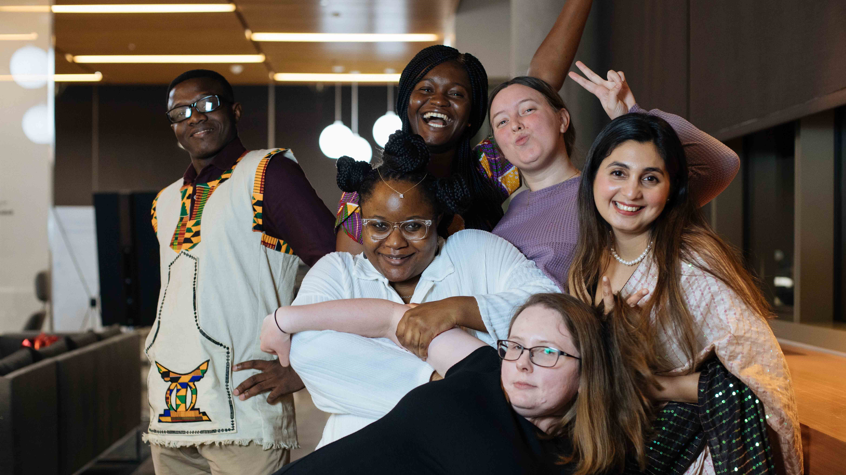
International Students Association, UNTHSC
Welcomes you

Slide 2


Who are we?
Student organization for internationals and “internationals at heart”
A family away from home

Slide 3

How do I get to school from the airport ?
Who do I talk to when I need help ?
How do I find my way around?
I am roommate-hunting!
How do I find accommodation?
How do I open a bank account?
I NEED FRIENDS !
Where is the closest grocery store?
Are there places of worship close-by?
What is a Social Security Number !?
Where do y’all go for fun ?
What does it feel like to live in Fort worth?

Slide 4
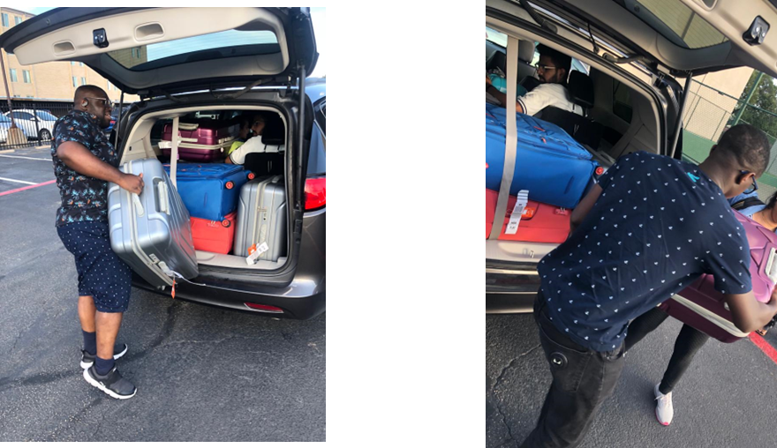

Plans For You!!!!!!
Airport pickup
Accommodation scouting
Help you settle in
Be your new family (if you need one, that is)
Join the Whatsapp page for more details !

Slide 5
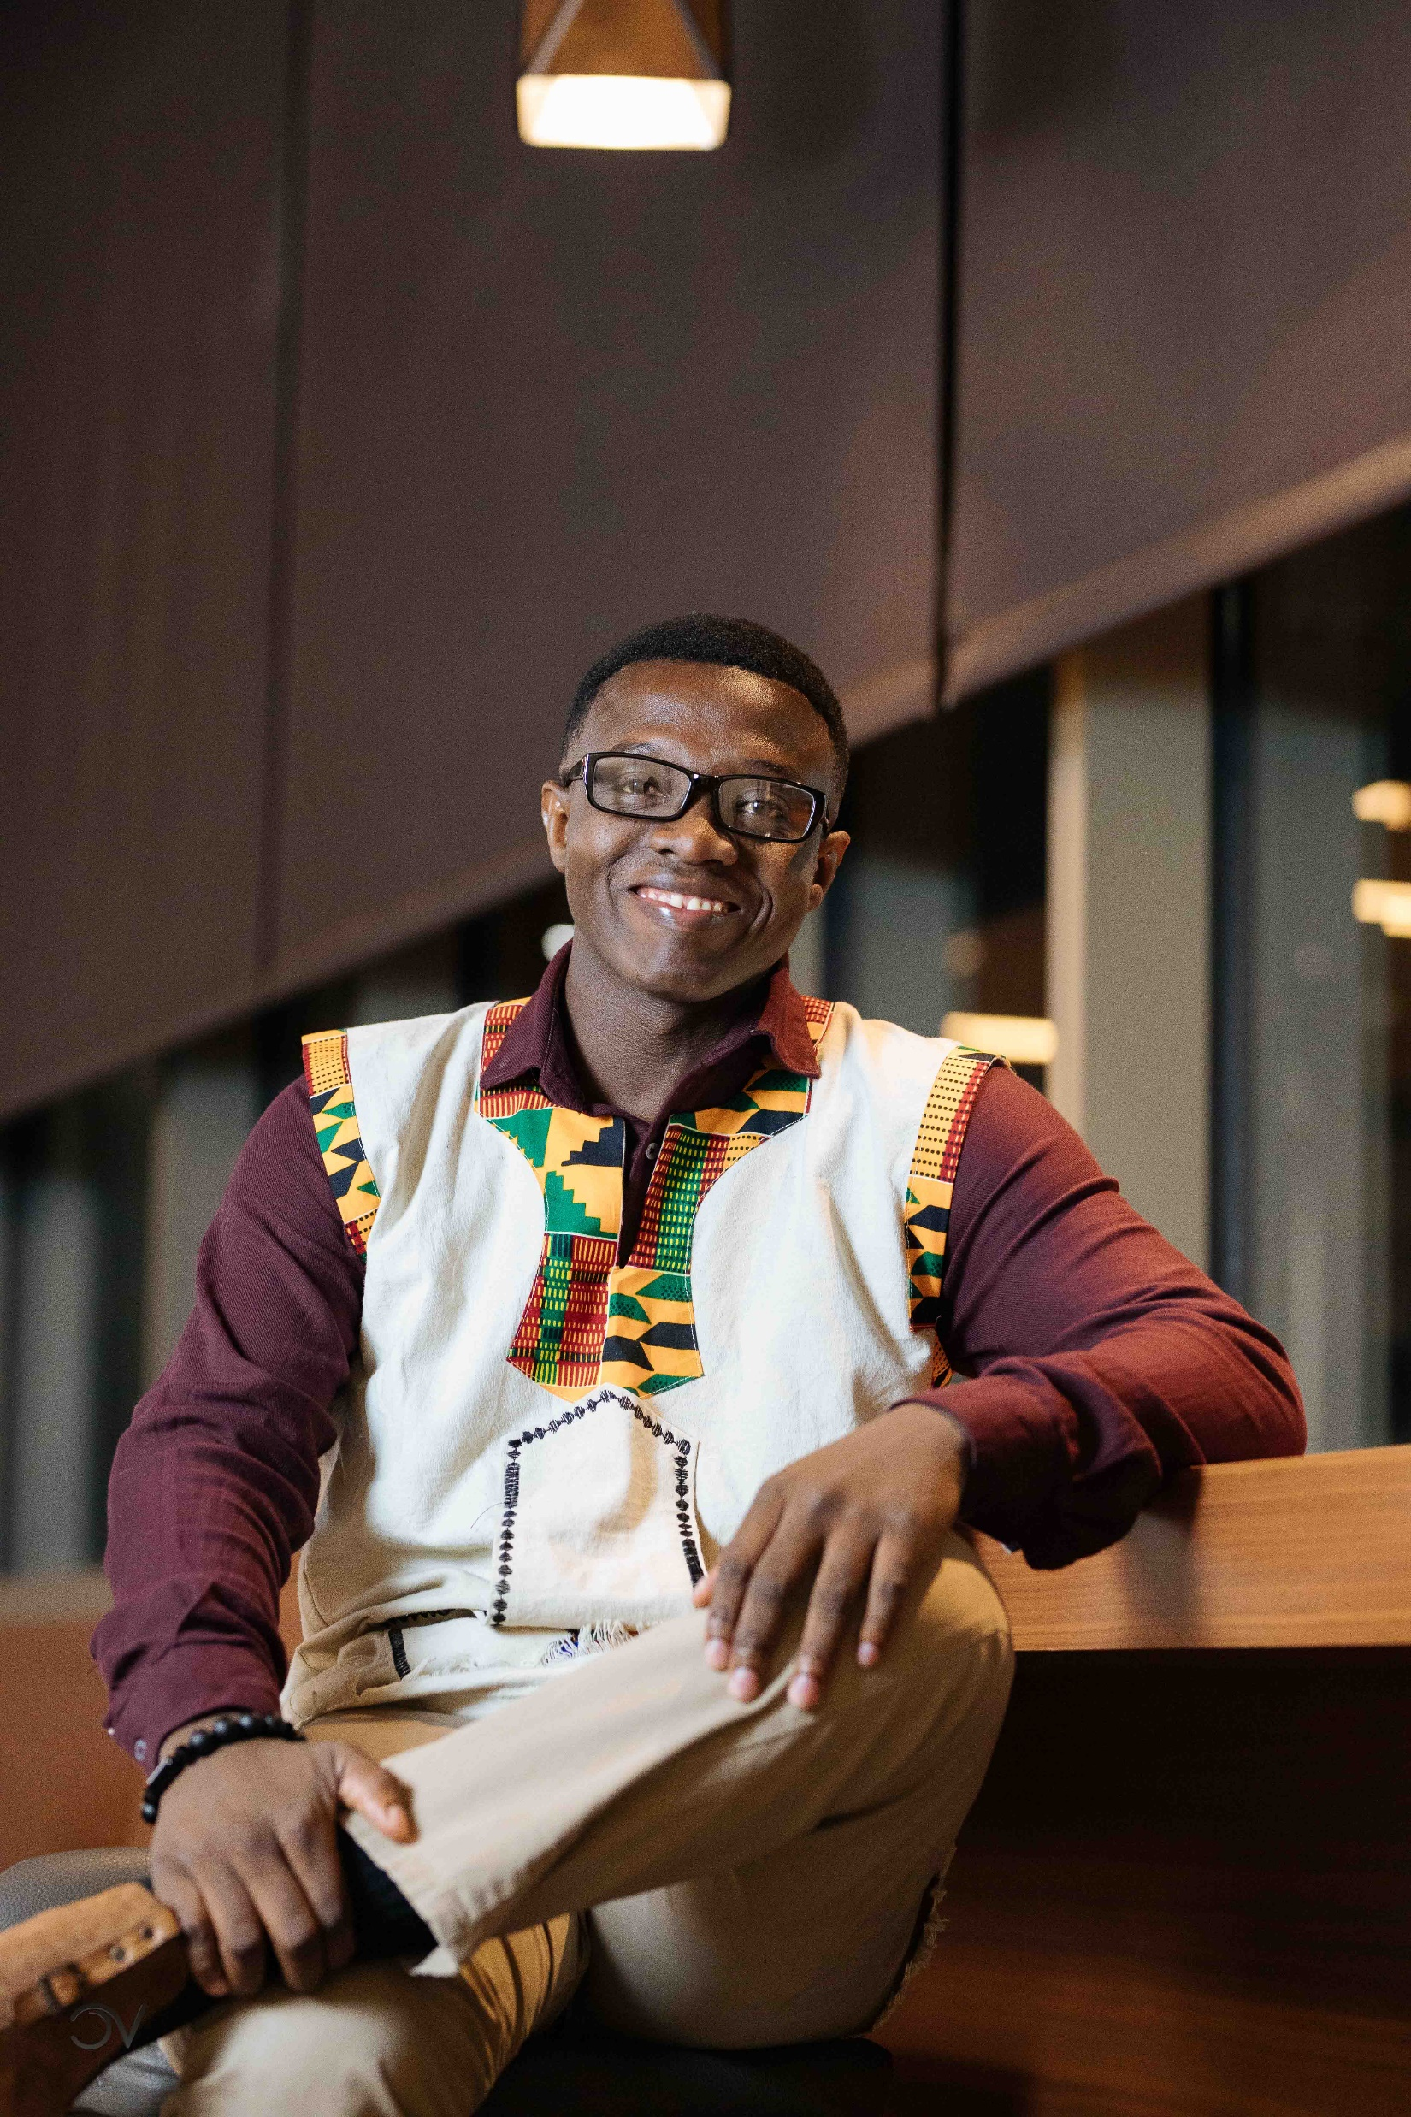
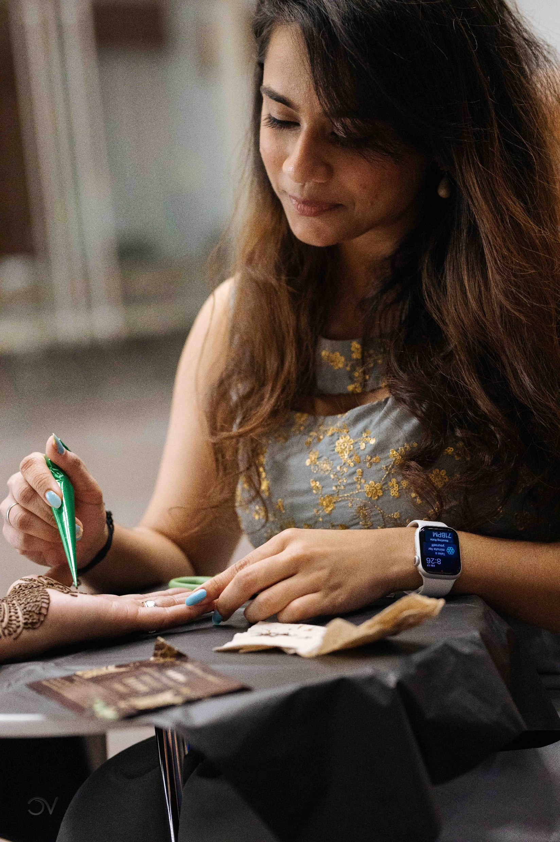
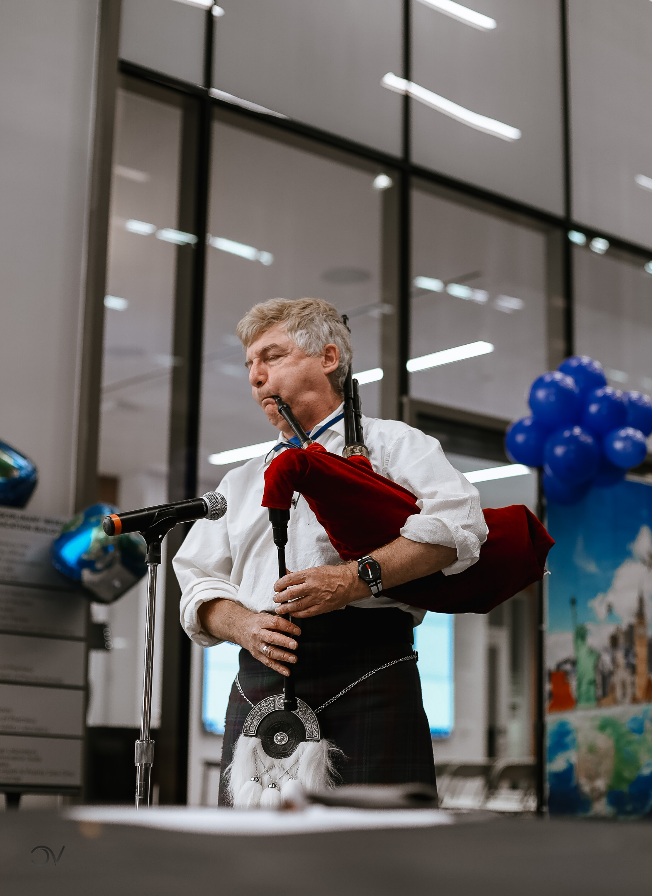
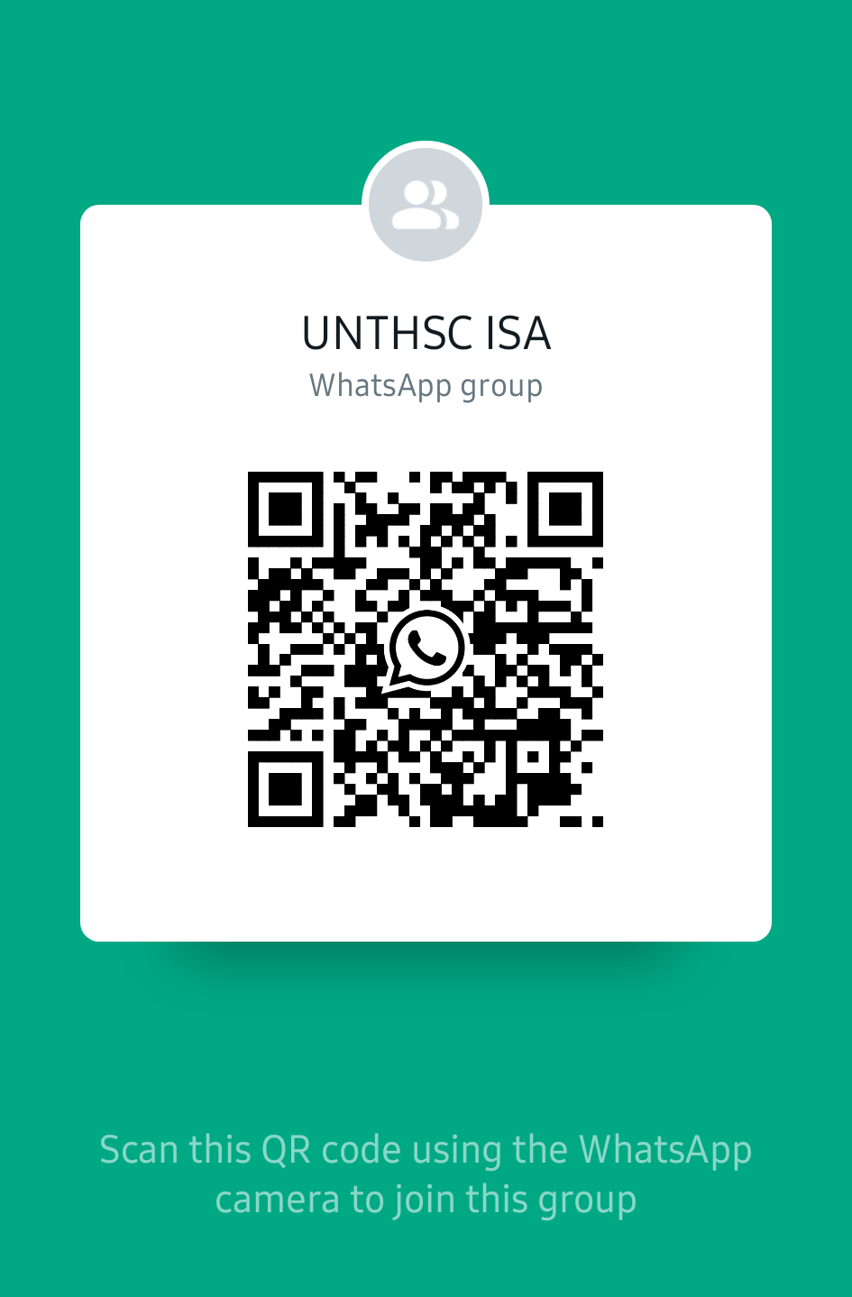


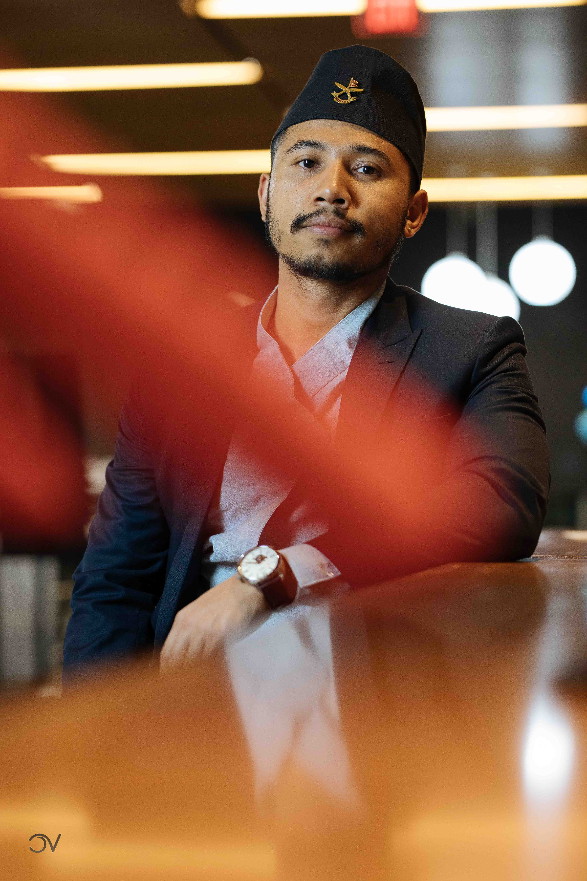
Connect with us
Whatsapp
Instagram (UNTHSC_ISA)

