Slide 1
The Office of Student Finance

Slide 2
Contact Information
Tiffinie Jones - Director
 SSC 150
Elisha DeClue – Waivers / Customer Service
 SSC 150A  817-735-2026
Michele Duncan-Grays – 1098T
 SSC 151
 817-735-2597
Peggy Jacobs – Third Party
 SSC 159
 817-735-0676
Renee Perez– Student Accounts/Collections/Refunds
 SSC 151A
Thresia Taylor - Cashier/Customer Service
 SSC 101
 817-735-2534

Slide 3
Location
Location and Hours:
Student Service Center (SSC)
1051 Haskell St., Fort Worth TX 76106
Cashier’s Office
SSC Suite 101, 1st Flr
M - F 8:15 am – 4:30 pm
Student Finance Office
SSC Suite 150, 1st Flr
M – F 8am – 5pm

Slide 4
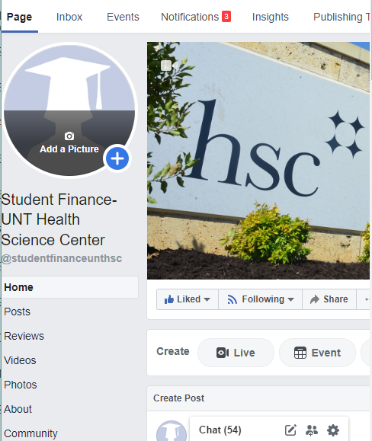
Services We Provide
Cashier Services
Student Accounts
Payments
3rd Party Sponsors
Installment Plans
Waivers & Exemptions
Refunds
1098-T

Slide 5
Student Financial Obligation Agreement
Key points to remember
A STUDENT WHO FAILS TO MAKE FULL PAYMENT OF TUITION AND FEES, INCLUDING ANY INCIDENTAL FEES, BY THE DUE DATE MAY BE PROHIBITED FROM REGISTERING FOR CLASSES UNTIL FULL PAYMENT IS MADE. A STUDENT WHO FAILS TO MAKE FULL PAYMENT PRIOR TO THE END OF THE TERM MAY BE DENIED CREDIT FOR THE WORK DONE THAT TERM

Slide 6
Payment Options
In Person at Cashier’s Office
Online Payments thru Student Portal (MyHSC.edu)
Installment plans available
Payments are due the day before classes start
Cash payments are NOT accepted through the mail

Slide 7
Installment Payment Plans
To choose the payment plan option login to your MyHSC and from the home page click Student Account >Make a payment >Payment options> Installment Plan
When you choose the installment plan the first payment is due BEFORE the first day of class
Keep in mind some fees are due in total regardless of payment plan. (ex. Health insurance)

Slide 8
Third Party Payments
Vendor/Sponsor must sign a contract (promise of payment)
Student’s are also required to sign a 3rd Party contract
Contracts must be submitted 10 days prior to the first day of class
More information about Third Party contracts and billing can be found here
For any question related to Third Party Contract/Billing benefits
please email: ThirdParty@unthsc.edu or call 817-735-0676

Slide 9
Refunds
After your Financial Aid is disbursed, Student Finance will process refunds approximately 10 days prior to start of classes
Refunds are normally processed on Tuesdays and Thursdays
You may receive your refund via:
Direct deposit into your bank account
Paper check @ the Cashier’s Office (temporarily unavailable due to COVID-19)
You may sign up for direct deposit on your MyHSC Student Portal

Slide 10
1098-T
When
Disbursement Date January 31st
Where
MyHSC Student Portal or mailed to address on file
Why
The 1098-T tax form provides information about the amount of tuition and qualifying fees paid during the specified calendar year. This information can be used to receive an educational credit on your tax return

Slide 11
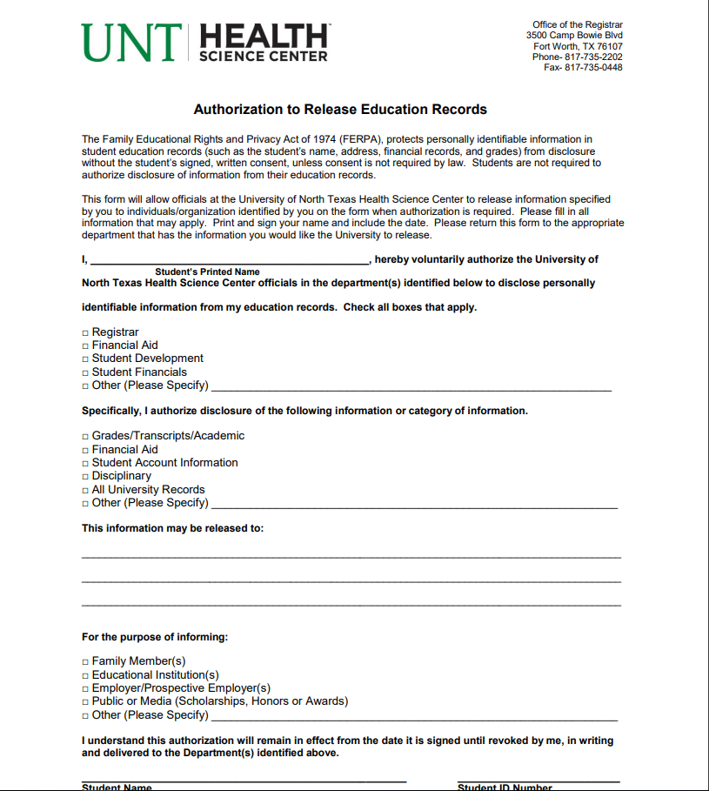
Authorization To Release Education Records
Form can be found on the Registrar’s webpage
Authorization to Release Education Records form

Slide 12
Personal Information
It is vital that your information with the school stays up to date.
Mailing Address Email Address Phone Number
Current Students – Update information on your Student Portal
Graduates - Update information with Alumni Association
or Registrar
All official school communication is sent to your university email.
It is your responsibility to check this. Remember you can forward email to your personal email.

Slide 13
Contact Information
 Monday – Friday
 8:00 – 5:00 pm
 817 -735 -2026
 StudentFin@unthsc.edu
 Website:
www.unthsc.edu/student-finance

