Slide 1

Framing the Issue: THE Need for collective Impact
IOM APOP
Texas CORD
STEVEN H KELDER, PhD , MPH
Beth Toby Grossman Distinguished Professor of Spirituality and Healing

Slide 2


Thank you for inviting me!

Slide 3

Obesity: a scourge worldwide

Slide 4
NHANES Age 12-20
All 34%
White 31%
Black 41%
Hispanic 42%
Overweight is defined as 85-95 percentile
Obese is defined between the 95% and 120% of 95 percentile
Severely Obese is defined as greater than 120% of the 95th percentile

Slide 5
NHANES, Severely Obese
Age 12-20 by Subgroup
Severely Obese is defined as greater than 120% of the 95th percentile

Slide 6
NHANES Age 12-20
How many kids are we talking about?
Overweight is defined as 85-95 percentile
Obese is defined between the 95% and 120% of 95 percentile
Severely Obese is defined as greater than 120% of the 95th percentile

Slide 7
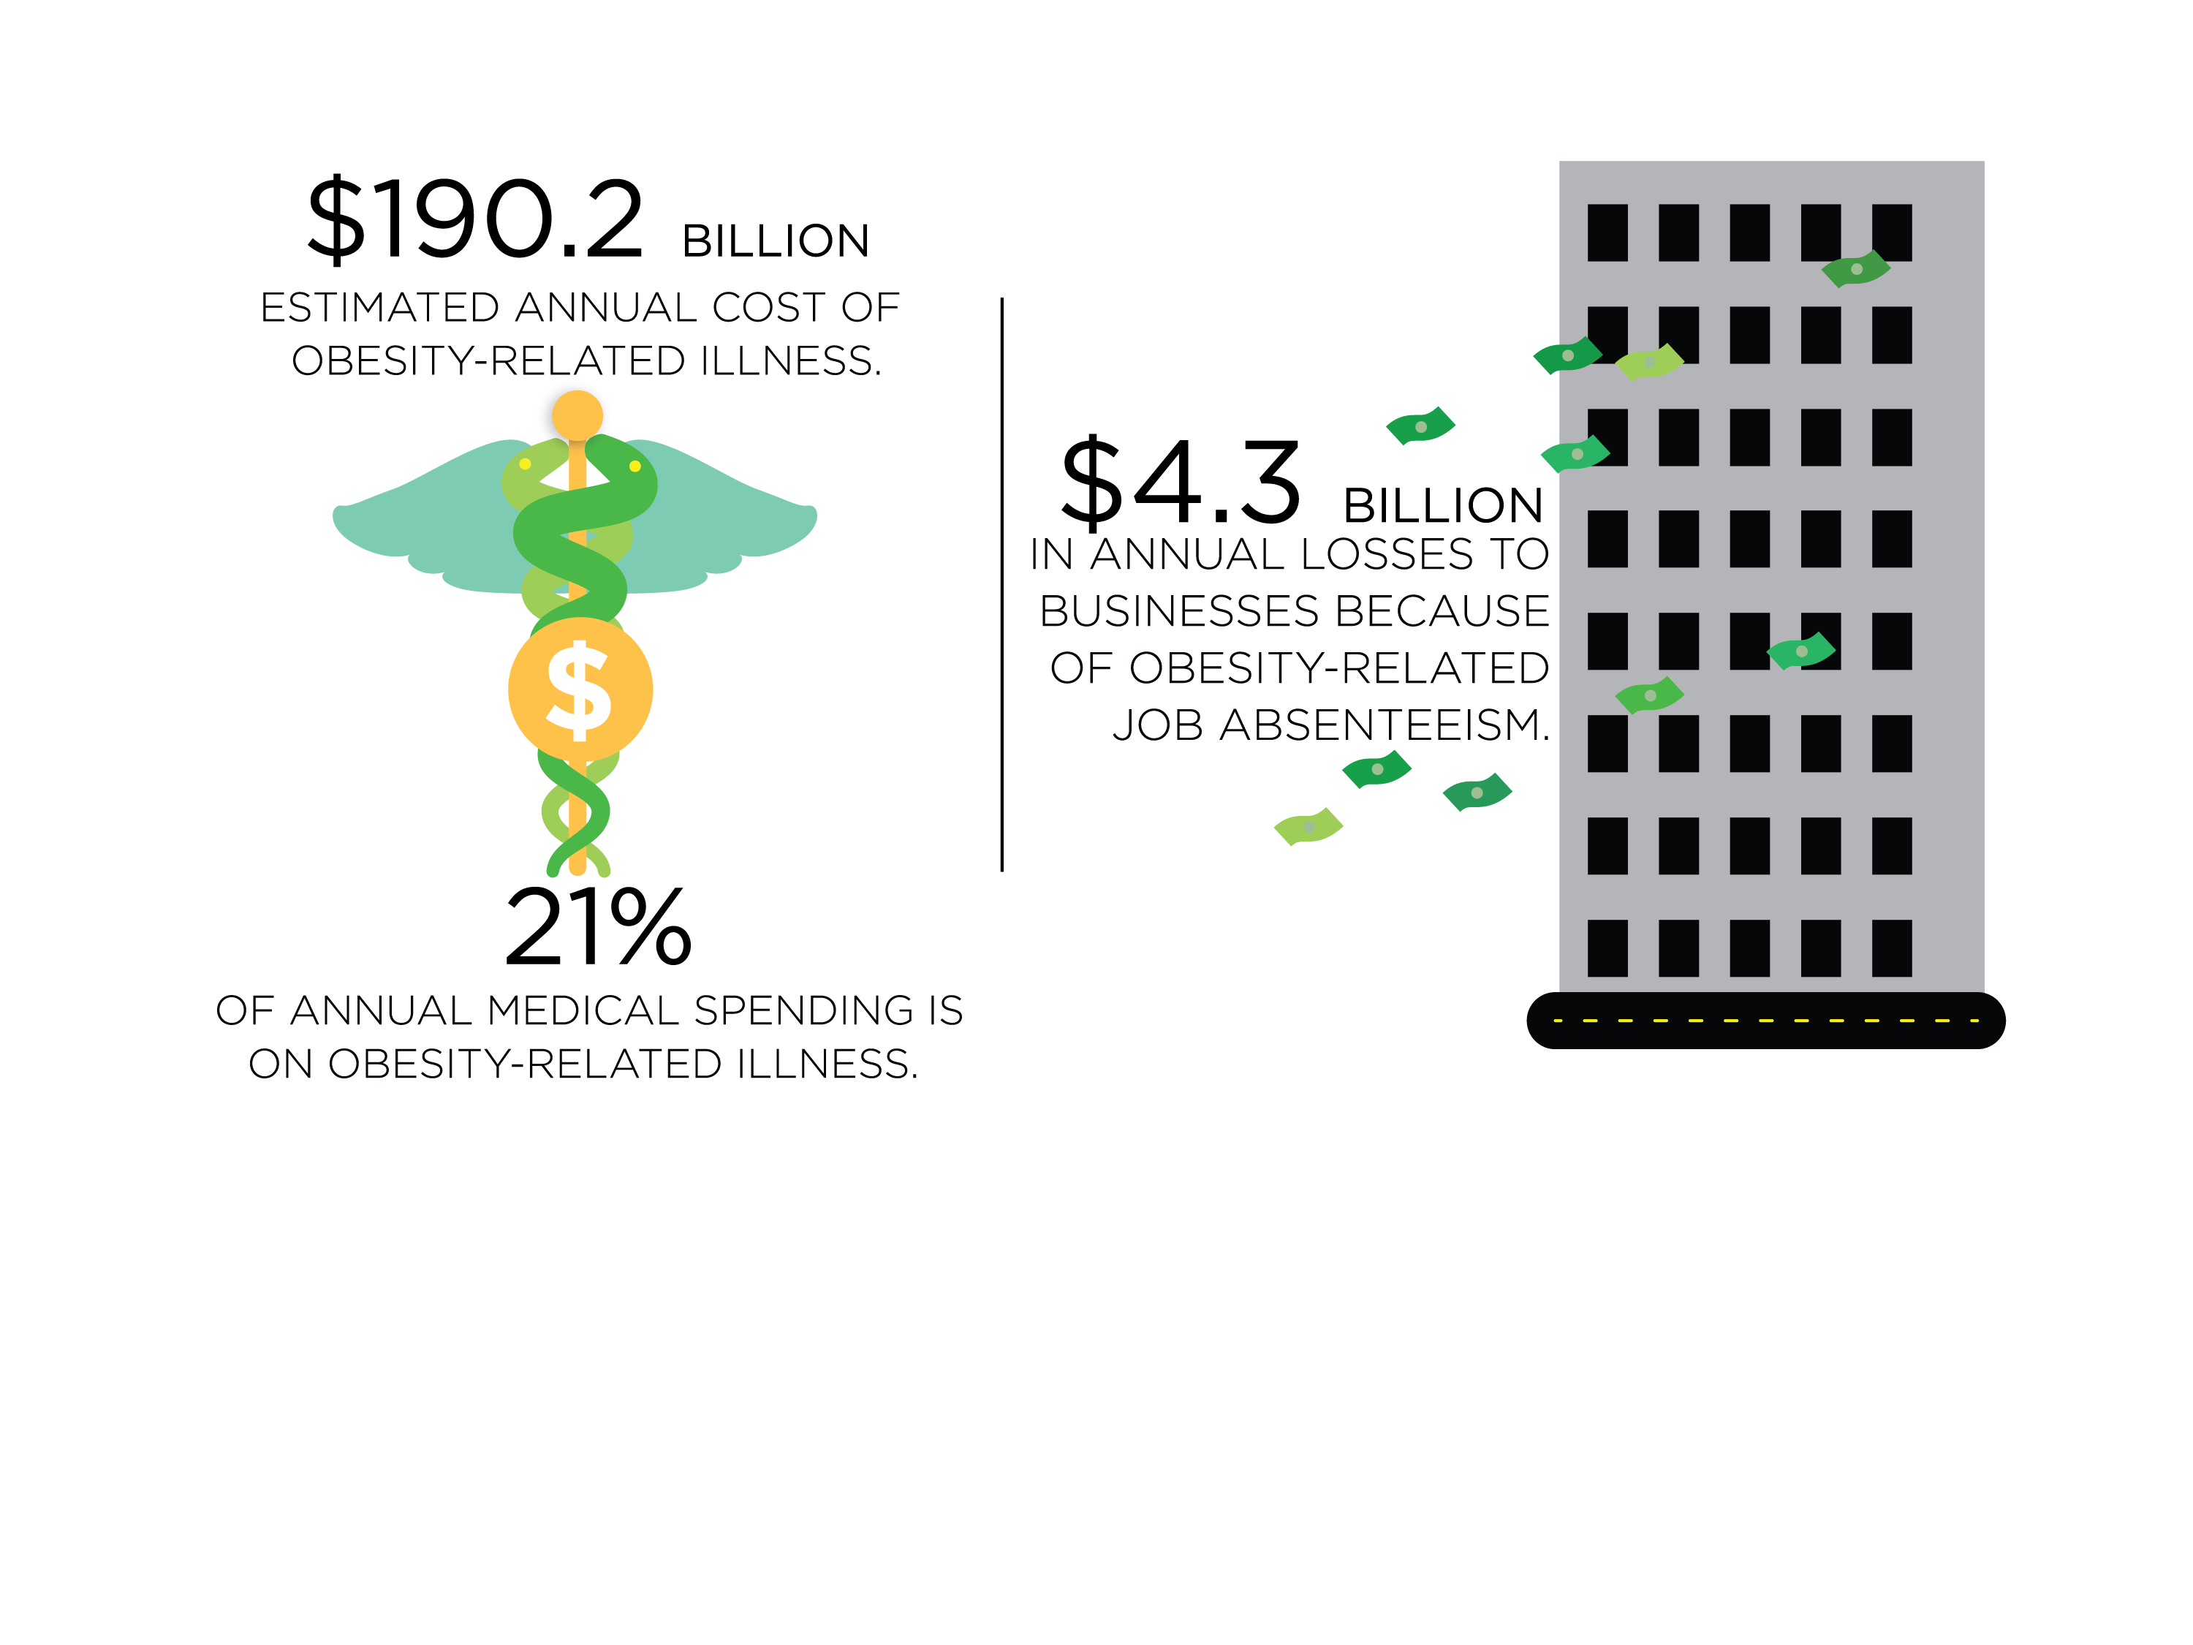
Scope and Societal Costs
Notes:
These health consequences in turn:
Cost the country an estimated $190.2 billion in obesity-related illnesses…that represents 20% of all health care spending.
An estimated loss of $4.3 billion dollars to businesses because of obesity-related absenteeism.

Slide 8

Accelerating Progress in Obesity Prevention (APOP)
Sponsored by
The Robert Wood Johnson Foundation
with Michael & Susan Dell Foundation

Slide 9

Goals
Integrate Physical Activity Every Day in Every Way
Make Healthy Foods Available Everywhere
Market What Matters for a Healthy Life
Activate Employers and Health Care Professionals
Strengthen Schools as the Heart of Health
Notes:
(Bill)
Goals
Utilizing the committee’s guiding principles, the committee identified 5 goals that helps sum up the actions that we recommended:
Integrate Physical Activity Every Day in Every Way
Make Healthy Foods Available Everywhere
Market What Matters for a Healthy Life
Activate Employers and Health Care Professionals
Strengthen Schools as the Heart of Health
In other words, focused action is needed in 5 critical areas: physical activity; food and beverage; message; health care and work; and school.

Slide 10


Physical Activity Strategies
Recommendation 1
Strategy 1-1: Enhance the physical and built environment.
Strategy 1-2: Provide and support community programs designed to increase physical activity.
Strategy 1-3: Adopt physical activity requirements for licensed child care providers (15 min per hour)
Strategy 1-4: Provide support for the science and practice of physical activity.
Notes:
Note that physical education and opportunities for physical activity in schools are covered in Recommendation 5, on school environments.

Slide 11
Physical Activity Strategies
Recommendation 1
Strategy 1-1: Enhance the physical and built environment (HB 1102; SB 565).
Strategy 1-2: Provide and support community programs designed to increase physical activity (HB 128, 137, 924).
Strategy 1-3: Adopt physical activity requirements for licensed child care providers (15 min per hour)
Strategy 1-4: Provide support for the science and practice of physical activity.
Notes:
Note that physical education and opportunities for physical activity in schools are covered in Recommendation 5, on school environments.

Slide 12



Strategy 1-4: Provide support for the science and practice of physical activity
Notes:
Strategy 1-4: Federal, state, and local government agencies should make physical activity a national health priority through support for the translation of scientific evidence into best-practice applications.
Feds:
establish processes for regular and routine communication of latest available science related to the health benefits of PA
-could be done through regularly scheduled updates to PA Guidelines for Americans (akin to the 5-year cycle for the DGA) and updates of Surgeon General’s report (last issued in 1996)
Develop priority strategies to promote and support the National PA Plan—trans-sector strategy for increasing PA—directly ties in with the committee’s systems thinking approach
State/local:
Develop plans/strategies for making PA a health priority

Slide 13
Food and Beverage Strategies
Recommendation 2
Strategy 2-1: Adopt policies and implement practices to reduce overconsumption of sugar-sweetened beverages.
Strategy 2-2: Increase the availability of lower-calorie and healthier food and beverage options for children in restaurants.
Strategy 2-3: Use strong nutritional standards for all foods and beverages sold or provided through the government, and ensure that these healthy options are available in all places frequented by the public.
Strategy 2-4: Use financial incentives and zoning strategies to improve local food environments, linking incentives to stores that commit to healthy food promotion.
Strategy 2-5: Examine the effects of U.S. agriculture policies on diets and obesity.
Notes:
(Jamie)

Slide 14
Food and Beverage Strategies
Recommendation 2
Strategy 2-1: Adopt policies and implement practices to reduce overconsumption of sugar-sweetened beverages (SB 493; HB 779. 735,
Strategy 2-2: Increase the availability of lower-calorie and healthier food and beverage options for children in restaurants.
Strategy 2-3: Use strong nutritional standards for all foods and beverages sold or provided through the government, and ensure that these healthy options are available in all places frequented by the public (HB 523, 751, 948, 1101. 1827, 3434)
Strategy 2-4: Use financial incentives and zoning strategies to improve local food environments, linking incentives to stores that commit to healthy food promotion (SB 133, 415, 403; HB254,725, 1221, 3616, 3631).
Strategy 2-5: Examine the effects of U.S. agriculture policies on diets and obesity.
Notes:
(Jamie)

Slide 15

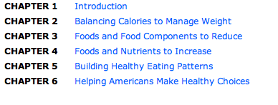

Slide 16
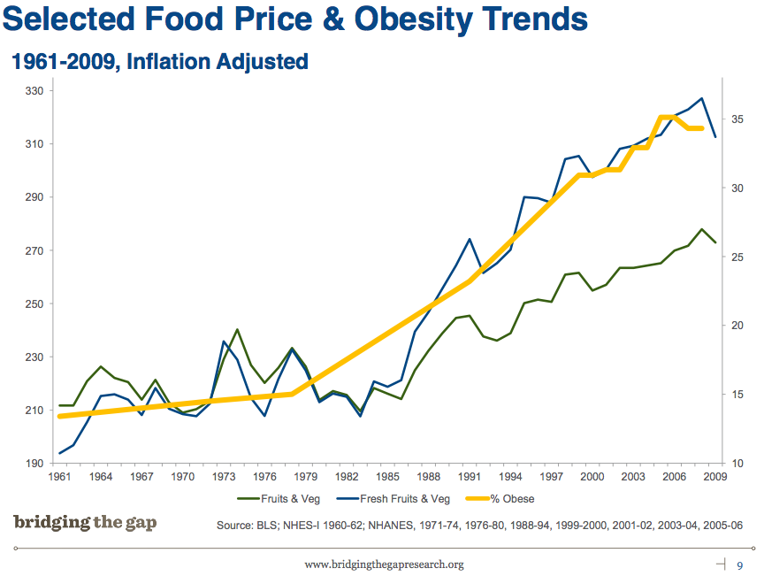

Slide 17
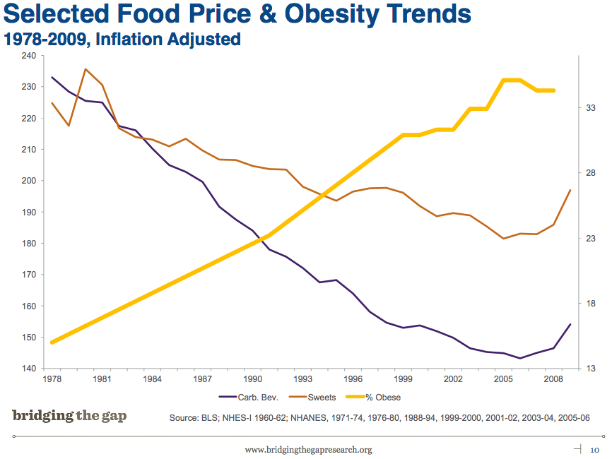

Slide 18
Messaging Strategies
Recommendation 3
Strategy 3-1: Develop and support a sustained, targeted physical activity and nutrition social marketing program.
Strategy 3-2: Implement common standards for marketing foods and beverages to children and adolescents.
Strategy 3-3: Ensure consistent nutrition labeling for the front of packages, retail store shelves, and menus and menu boards that encourages healthier food choices.
Strategy 3-4: Adopt consistent nutrition education policies for federal programs with nutrition education components.
Notes:
(Steve)
Strategy 3-1: Congress, the administration, other federal policy makers, and foundations should dedicate substantial funding and support to the development and implementation of a robust and sustained social marketing program on physical activity and nutrition. This program should encompass carefully targeted, culturally appropriate messages aimed at specific audiences (e.g., tweens, new parents, mothers); clear behavior-change goals (e.g., take a daily walk, reduce consumption of sugar-sweetened beverages among adolescents, introduce infants to vegetables, make use of the new front-of-package nutrition labels); and related environmental change goals (e.g., improve physical environments, offer better food choices in public places, increase the availability of healthy food retailing).
Strategy 3-2: The food, beverage, restaurant, and media industries should take broad, common, and urgent voluntary action to make substantial improvements in their marketing aimed directly at children and adolescents aged 2-17. All foods and beverages marketed to this age group should support a diet that accords with the Dietary Guidelines for Americans in order to prevent obesity and risk factors associated with chronic disease risk. Children and adolescents should be encouraged to avoid calories from foods that they generally overconsume (e.g., products high in sugar, fat, and sodium) and to replace them with foods they generally underconsume (e.g., fruits, vegetables, and whole grains). The standards set for foods and beverages marketed to children and adolescents should be widely publicized and easily available to parents and other consumers. They should cover foods and beverages marketed to children and adolescents aged 2-17 and should apply to a broad range of marketing and advertising practices, including digital marketing and the use of licensed characters and toy premiums. If such marketing standards have not been adopted within 2 years by a substantial majority of food, beverage, restaurant, and media companies that market foods and beverages to children and adolescents, policy makers at the local, state, and federal levels should consider setting mandatory nutritional standards for marketing to this age group to ensure that such standards are implemented.
Strategy 3-3: The Food and Drug Administration (FDA) and the U.S. Department of Agriculture (USDA) should implement a standard system of nutrition labeling for the front of packages and retail store shelves that is harmonious with the Nutrition Facts panel, and restaurants should provide calorie labeling on all menus and menu boards.
Strategy 3-4: USDA should update the policies for Supplemental Nutrition Assistance Program Education (SNAP-Ed) and the policies for other federal programs with nutrition education components to explicitly encourage the provision of advice about types of foods to reduce in the diet, consistent with Dietary Guidelines for Americans.

Slide 19
Messaging Strategies
Recommendation 3
Strategy 3-1: Develop and support a sustained, targeted physical activity and nutrition social marketing program (HB197).
Strategy 3-2: Implement common standards for marketing foods and beverages to children and adolescents.
Strategy 3-3: Ensure consistent nutrition labeling for the front of packages, retail store shelves, and menus and menu boards that encourages healthier food choices.
Strategy 3-4: Adopt consistent nutrition education policies for federal programs with nutrition education components.
Notes:
(Steve)
Strategy 3-1: Congress, the administration, other federal policy makers, and foundations should dedicate substantial funding and support to the development and implementation of a robust and sustained social marketing program on physical activity and nutrition. This program should encompass carefully targeted, culturally appropriate messages aimed at specific audiences (e.g., tweens, new parents, mothers); clear behavior-change goals (e.g., take a daily walk, reduce consumption of sugar-sweetened beverages among adolescents, introduce infants to vegetables, make use of the new front-of-package nutrition labels); and related environmental change goals (e.g., improve physical environments, offer better food choices in public places, increase the availability of healthy food retailing).
Strategy 3-2: The food, beverage, restaurant, and media industries should take broad, common, and urgent voluntary action to make substantial improvements in their marketing aimed directly at children and adolescents aged 2-17. All foods and beverages marketed to this age group should support a diet that accords with the Dietary Guidelines for Americans in order to prevent obesity and risk factors associated with chronic disease risk. Children and adolescents should be encouraged to avoid calories from foods that they generally overconsume (e.g., products high in sugar, fat, and sodium) and to replace them with foods they generally underconsume (e.g., fruits, vegetables, and whole grains). The standards set for foods and beverages marketed to children and adolescents should be widely publicized and easily available to parents and other consumers. They should cover foods and beverages marketed to children and adolescents aged 2-17 and should apply to a broad range of marketing and advertising practices, including digital marketing and the use of licensed characters and toy premiums. If such marketing standards have not been adopted within 2 years by a substantial majority of food, beverage, restaurant, and media companies that market foods and beverages to children and adolescents, policy makers at the local, state, and federal levels should consider setting mandatory nutritional standards for marketing to this age group to ensure that such standards are implemented.
Strategy 3-3: The Food and Drug Administration (FDA) and the U.S. Department of Agriculture (USDA) should implement a standard system of nutrition labeling for the front of packages and retail store shelves that is harmonious with the Nutrition Facts panel, and restaurants should provide calorie labeling on all menus and menu boards.
Strategy 3-4: USDA should update the policies for Supplemental Nutrition Assistance Program Education (SNAP-Ed) and the policies for other federal programs with nutrition education components to explicitly encourage the provision of advice about types of foods to reduce in the diet, consistent with Dietary Guidelines for Americans.

Slide 20
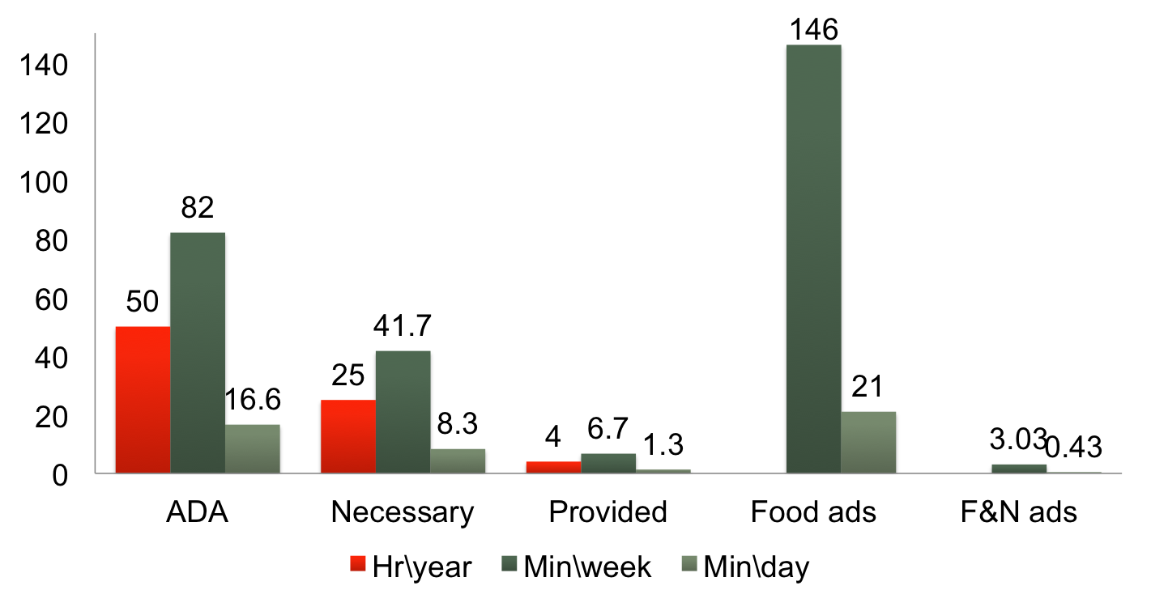
How Much Nutrition Education is Enough?
7600 food ads/year
153 F&N/ year
Briggs, M., et. al, (2010). Position of the American Dietetic Association, School Nutrition Association, and Society for Nutrition Education: comprehensive school nutrition services. Journal of nutrition education and behavior, 42(6), 360-71. Society for Nutrition Education.
Kann, L., et. al, (2007). Health Education: Results from the School Health Policies and Programs Study 2006. The Journal of school health, 77(8), 408-34. doi:10.1111/j.1746-1561.2007.00228.

Slide 21
Health Care, Insurers, and Worksites
Recommendation 4
Strategy 4-1: Provide standardized care and advocate for healthy community environments.
Strategy 4-2: Ensure coverage of, access to, and incentives for routine obesity prevention, screening, diagnosis, and treatment.
Strategy 4-3: Encourage active living and healthy eating at work.
Strategy 4-4: Encourage healthy weight gain during pregnancy and breastfeeding, and promote breastfeeding-friendly environments.
Notes:
Strategy 4-1: All health care providers should adopt standards of practice (evidence-based or consensus guidelines) for prevention, screening, diagnosis, and treatment of overweight and obesity to help children, adolescents, and adults achieve and maintain a healthy weight, avoid obesity-related complications, and reduce the psychosocial consequences of obesity. Health care providers should also advocate, on behalf of their patients, for improved physical activity and diet opportunities in their patients’ communities.
Strategy 4-2: Insurers (both public and private) should ensure that health insurance coverage and access provisions address obesity prevention, screening, diagnosis, and treatment.
Strategy 4-3: Worksites should create, or expand, healthy environments by establishing, implementing, and monitoring policy initiatives that support wellness.
Strategy 4-4: Health service providers and employers should adopt, implement, and monitor policies that support healthy weight gain during pregnancy and the initiation and continuation of breastfeeding. Population disparities in breastfeeding should be specifically addressed at the federal, state, and local levels to remove barriers and promote targeted increases in breastfeeding initiation and continuation.

Slide 22
School Strategies
Recommendation 4
Strategy 5-1: Require quality physical education and opportunities for physical activity in schools.
Strategy 5-2: Ensure strong nutritional standards for all foods and beverages sold or provided through schools.
Strategy 5-3: Ensure food literacy, including skill development, in schools.
Notes:
Strategy 5-1: Through support from federal and state governments, state and local education agencies and local school districts should ensure that all students in grades K-12 have adequate opportunities to engage in 60 minutes of physical activity per school day. This 60-minute goal includes access to and participation in quality physical education.
Strategy 5-2: All government agencies (federal, state, local, and school district) providing foods and beverages to children and adolescents have a responsibility to provide those in their care with foods and beverages that promote their health and learning. The 2010 Dietary Guidelines for Americans provide specific science-based recommendations for optimizing dietary intake to prevent disease and promote health. Implementation of these guidelines would shift children’s and adolescents’ dietary intake to prevent obesity and risk factors associated with chronic disease risk by increasing the amounts of fruits, vegetables, and high-fiber grains they consume; decreasing their consumption of sugar-sweetened beverages, dietary fat in general, solid fats, and added sugars; and ensuring age-appropriate portion sizes of meals and other foods and beverages. Federal, state, and local decision makers are responsible for ensuring that nutrition standards based on the Dietary Guidelines are adopted by schools; these decision makers, in partnership with regulatory agencies, parents, teachers, and food manufacturers, also are responsible for ensuring that these standards are implemented fully and that adherence is monitored so as to protect the health of the nation’s children and adolescents.
Strategy 5-3: Through leadership and guidance from federal and state governments, state and local education agencies should ensure the implementation and monitoring of sequential food literacy and nutrition science education, spanning grades K-12, based on the food and nutrition recommendations in the Dietary Guidelines for Americans.

Slide 23
School Strategies
Recommendation 4
Strategy 5-1: Require quality physical education and opportunities for physical activity in schools. (SB 134, 525; HB 275, 276, 277, 1018)
Strategy 5-2: Ensure strong nutritional standards for all foods and beverages sold or provided through schools (SB 1785, 1786, 317, 376; HB 217, 296).
Strategy 5-3: Ensure food literacy, including skill development, in schools.
Notes:
Strategy 5-1: Through support from federal and state governments, state and local education agencies and local school districts should ensure that all students in grades K-12 have adequate opportunities to engage in 60 minutes of physical activity per school day. This 60-minute goal includes access to and participation in quality physical education.
Strategy 5-2: All government agencies (federal, state, local, and school district) providing foods and beverages to children and adolescents have a responsibility to provide those in their care with foods and beverages that promote their health and learning. The 2010 Dietary Guidelines for Americans provide specific science-based recommendations for optimizing dietary intake to prevent disease and promote health. Implementation of these guidelines would shift children’s and adolescents’ dietary intake to prevent obesity and risk factors associated with chronic disease risk by increasing the amounts of fruits, vegetables, and high-fiber grains they consume; decreasing their consumption of sugar-sweetened beverages, dietary fat in general, solid fats, and added sugars; and ensuring age-appropriate portion sizes of meals and other foods and beverages. Federal, state, and local decision makers are responsible for ensuring that nutrition standards based on the Dietary Guidelines are adopted by schools; these decision makers, in partnership with regulatory agencies, parents, teachers, and food manufacturers, also are responsible for ensuring that these standards are implemented fully and that adherence is monitored so as to protect the health of the nation’s children and adolescents.
Strategy 5-3: Through leadership and guidance from federal and state governments, state and local education agencies should ensure the implementation and monitoring of sequential food literacy and nutrition science education, spanning grades K-12, based on the food and nutrition recommendations in the Dietary Guidelines for Americans.

Slide 24

HBO’s The Weight of the Nation
Documentaries (4) for adult audience
Short documentaries (12) on specific topics in
obesity prevention
Documentaries (3) for children and families
Trade publication for general audiences
Website (http://theweightofthenation.hbo.com/)
Social media (Facebook, Twitter, Youtube, and GetGlue)
Screening kits with discussion guides
Marketing efforts, including reaching families with children
Written materials for school-age children and teachers (Scholastic, Inc.)

Slide 25
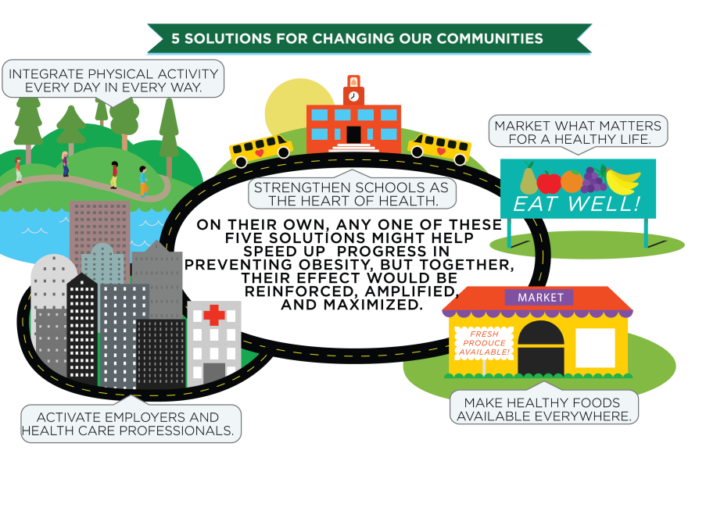
Accelerating Progress in Obesity Prevention

Slide 26


Slide 27
Texas childhood obesity demonstration project (CORD)
To implement and evaluate a primary prevention obesity program in low-income, ethnically diverse catchment areas in Austin and Houston
To implement and evaluate the efficacy of a systems approach to child obesity on reducing BMI z-scores by embedding a 12-month family-based secondary prevention program within a community primary prevention program.
To quantify the incremental cost-effectiveness of the 12-month family-based secondary prevention program relative to primary prevention alone.

Slide 28
Texas CORD Study Team
Michael & Susan Dell Center, UTSPH
  Deanna Hoelscher, PI
  Steve Kelder
  Elizabeth Vandewater
  Shreela Sharma
Children’s Nutrition Research Center,
  Nancy Butte, PI
  Sarah Barlow
Texas Department of State Health Services
MEND Central/MEND Foundation
  Paul Sacher
  Paul Chadwick
University of Nebraska Medical Center
  Terry Huang
Seton Healthcare System
  Stephen Pont
Duke University, Singapore
  Eric Finkelstein
ACTIVE Life
  Baker Harrell

Slide 29

The Need
Low income children are more likely to be overweight or obese, due to physical, socioeconomic and cultural barriers.
Annual healthcare costs for an obese child with Medicaid was about $6700 compared to $3700 for an obese child covered by private insurance.
16.5% of Texas children under age 18 had no insurance (national average of 10%)
In 2009, one in eight Texans relied on Medicaid for insurance.

Slide 30
Findings to Benefit Many
Objective:
  To determine whether the CORD model can improve underserved children’s risk factors for obesity.
  To generate knowledge (improve care, reduce costs) that can be translated, developed, implemented, sustained, and brought to scale.
    Lessons learned will benefit > 7 M children on CHIP
    If CORD is effective, it could be replicated in other programs (Medicaid, private insurance).

Slide 31


Slide 32
Primary Prevention - PLUS - Secondary Prevention
Primary Prevention
Secondary Prevention
Efforts targeting the entire population
Healthy weight as well as overweight/obese children
Prevention of child obesity
Efforts focus on overweight and obese children
Prevent disease progression and development of co-morbidities

Slide 34
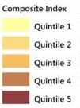
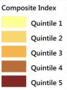
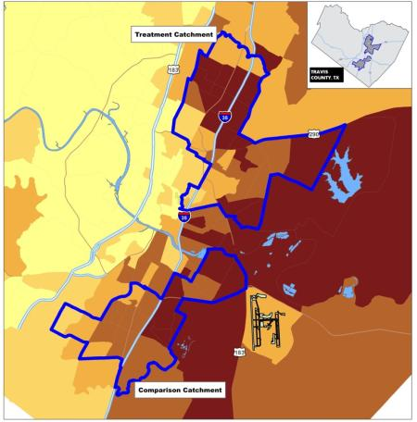
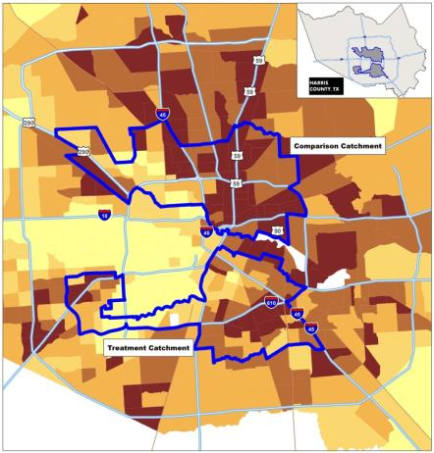
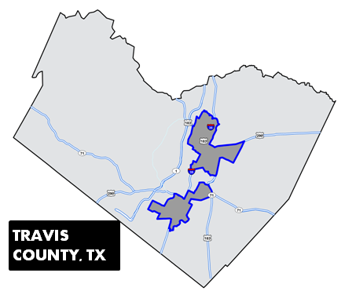
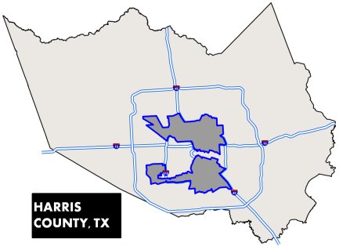


AUSTIN, TX.
HOUSTON, TX.

Slide 35

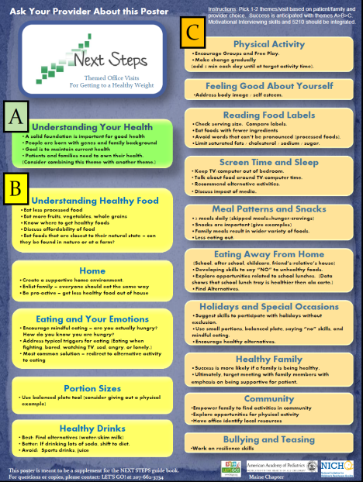

Intervention Components – Primary Prevention
CATCH Early Childhood (pre-K and Head
Start)
CATCH Elementary School
Health Care Clinics (Next Steps)
Social Media Campaign – It’s Time
Texas
Policy Training
Source: Hoelscher et al.,
2010; Hoelscher et al, 2010;
Coleman et al., 2005; Sharma
et al., in press

Slide 36
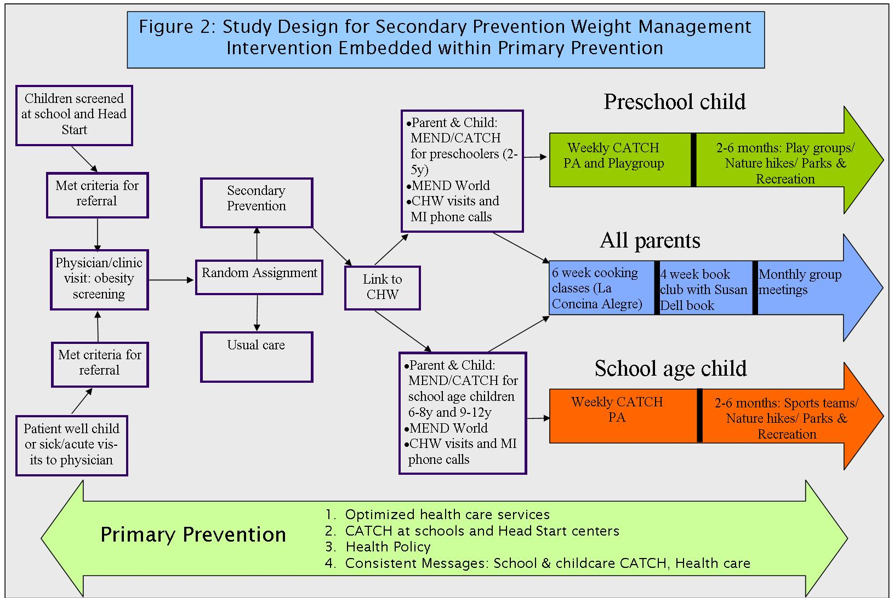

Slide 37



Intervention – Secondary Prevention
Preschool Child
  MEND 2-5 at YMCA
  CATCH Playgroups
School-aged Child
  MEND 6-8 and 9-12 at YMCA
  CATCH Structured Physical Activities & Sports Teams
  MEND World Online/Print Materials
  Parent support
    The Happy Kitchen/La Cocina Alegre
    Parent Group Discussion Sessions – Being Well
Community Health Workers
  Link to Primary Care & Community Services
  MEI
Branding & Social Media: ACTIVE LIFE
Source: Sacher et al., 2010

Slide 38

ITT & CORD
Current:
  Support the planning and implementation of text messaging campaign
Future:
  Add ITT-specific content to text messages

Slide 39

Two Text Messaging Campaigns

Slide 40
Secondary Prevention
Target audience: MEND parents
Goals
  Reinforce lessons learned through MEND
  Act as reminders to support monthly post-program goals
  Info about local healthy community events
Based on MEND monthly themes:
  Ex: Month 3: Meal Master Challenge: Go Green with fruits and veggies
  Ex: Month 4: Get Moving & Buddy Up
Frequency: 1 message per week

Slide 41
MEND text message examples
MEND monthly themes
  The theme for month 3 of the post program is Meal Master Challenge: Go Green with fruits and veggies
    Example: MEND Tip – make fruits and vegetables more interesting. Freeze grapes. Steam carrots w/ spices. Add peanut butter and raisins to celery.
  Month 4 of the post program is Get Moving & Buddy Up
    Example: MEND Tip – This Thursday, April 8, go to Zliker Park in Austin for a fun & FREE evening of soccer! More info here: http://bit.ly/34bi7
Healthy Community Events
  ITS TIME TEXAS
    Example: MEND Tip – This week is Healthy Texas Week! Find out how to host a Healthy House Party here: http://bit.ly/34bi8

Slide 42

Primary Prevention
Target audience: parents, teachers, personnel @ CORD sites
Goal: reinforce the parent & community component of CATCH
Goal: coordinate messaging across all sites
  Schools
  Clinics
  YMCA / Community partners
  Home
Messages based on CATCH
Coordination Toolkit’s
6-week themes:
Frequency: 4–5 messages
per week

Slide 43
A Typical Week of CATCH messages
2-3 messages with healthy tips and reminders in-line with the CATCH curriculum
  Ex: GO food recipe: Easy smoothies. Blend low-fat yogurt or milk with fresh fruit pieces and crushed ice. Or freeze the fruit first and skip the ice!
1 message per week featuring healthy food on sale at local HEB grocery
  Ex: This week at your local HEB, purchase 3 large mangos for only $1.00! Deal ends April 1. Find your nearest HEB: http://bit.ly/8763bk
1-2 messages per month with tips from our partner, IT’S TIME TEXAS
  Ex: This week is Healthy Texas Week! Find out how to host a Healthy House Party here: http://bit.ly/8l78bl
1 message (if desired) per month dedicated to school events, announcements, or activities.
  Ex: Family Fun Night at Sanchez Elementary this Thursday at 6pm! Free healthy GO snacks and fun, active games for everyone!

Slide 44
Conclusions
Be persistent: Systems-level programs need continual training and reminders
  Head Start, Primary Care Physicians
Coordinating of all aspects of program can be challenging
Recruitment can be difficult, especially for preschool children
Programs need to address the entire family
Partnerships are essential
  Community Transformation Grants (CTG)
  Advisory Committee

Slide 45
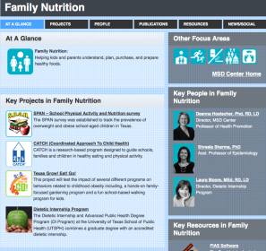



msdcenter.org

Slide 46
Twitter
@DrSteveKelder
@MSDCenter

