Slide 1
University of North Texas Health Science Center
Department of
Lab Animal Medicine
Policy Training

Slide 2
Overview
Presentation
Tour of vivarium
Animal handling

Slide 3
DLAM Staff
Monday – Friday, 7:00 am - 5:00 pm
Limited staff on weekends - if you need immediate assistance, please call Marcie Dorsett by cell phone
For general questions, contact Administrative Desk at x2017

Slide 4
DLAM Staff
Director/Veterinarian – Dr. Daniels, DVM
Facility Manager – Marcie Dorsett
Operations Analyst – Lacy Bowen
Animal Health Technician – Tito Nelson
Lab Animal Attendants – Staff who work in your rooms on a daily basis

Slide 5
Facility Access
Access granted after completion of the following:
  Online CITI Modules
  Medical History Questionnaire
  Added to the protocol via amendment by your PI
  Attend Policy Training & Hands-on Training
Key and access card request form signed by your supervisor, and DLAM, then submitted to campus police (this form must be separate from your lab key request)
Separate training for access to the ABSL2 suite

Slide 6
Facility Security
No unauthorized visitors are allowed in the vivarium
  Unless approved by the Director of DLAM or his designee
  Visitors must sign in at the DLAM office
Have your badge visible when inside the vivarium
Do not allow another individual to use your badge and/or keys

Slide 7


Laboratory Apparel
Wear clean lab coat or clean scrubs
Solid shoes (prefer rubber soles)
Avoid heavy cologne or perfume
Do not smoke in lab coat
NO CELL PHONES allowed in
  the animal facilities!

Slide 8
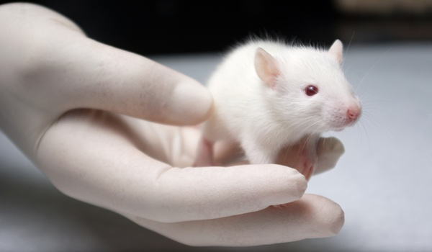
Occupational Health & Safety
Do not enter other animal rooms to prevent cross-contamination
Wear proper PPE when handling animals
  Gloves
  Mask
  Yellow gown
  May include shoe covers
Working with potential zoonotic species
Do not enter the “Clean Room”
Clean up after yourself
Do NOT place cages on the floor

Slide 9
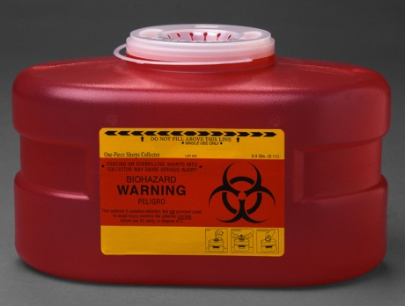
Occupational Health & Safety
Sharps containers
  All procedure rooms and labs must have sharps containers
  Do NOT leave needles in the room
  For disposal of full Sharps Containers contact x2181 and designated staff will pick them up (IACUC SOP # 017)
Fire alarms – Please exit the facility
Electronic devices are not permitted in the animal facility

Slide 10
Occupational
Health & Safety
Bites and Scratches
  Wash the area with soap and water
  Report the incident to your supervisor (they will decide if it should be reported to the Safety Office)
Allergies
  Most common health problem
  Wearing proper PPE can help prevent them
  If you do develop allergies, let your supervisor know

Slide 11
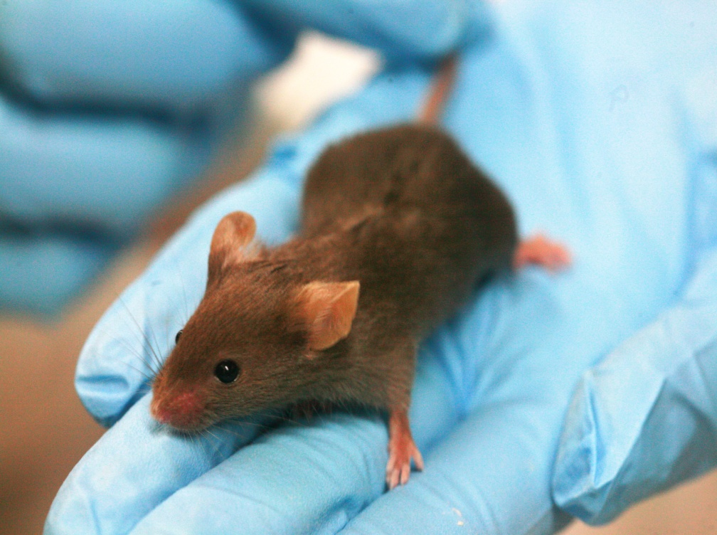
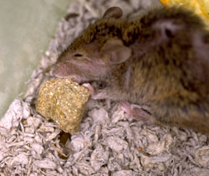
Animal Health &
Husbandry
Animal Health
  Assessed by DLAM staff in the morning and afternoon
  Notify DLAM staff immediately, and fill out an orange, Med Case card

Slide 12
Assessing Animal Health
Common things to look for in rodents:
  Activity level - lethargic
  Behavior – vocalizing, self-trauma, aggressive
  Food/Fluid intake – decreased feces/urine
  Eyes – red staining
  Fur – unkempt, soiled fur
  Posture – hunched
  Respiratory – open mouth, labored breathing
  Others – seizures, tremors, tumors, infected wounds, paralysis

Slide 13
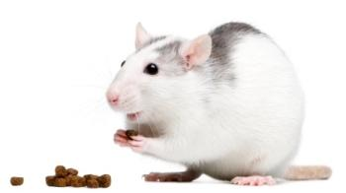
Animal Health &
Husbandry
Dead animals
  Place the animal in a glove or trash liner, and give it to DLAM staff for proper disposal
  If DLAM finds a dead animal, a notification will be left on the cage or on the door of the animal room
Cage changes/Room cleaning schedule
  The schedule is posted on the room door
  All caging is changed at least once every two weeks, some require more frequent changes
  Concerns/questions? Please contact Marcie
Feeding
  DLAM feed ad libitum, a pelleted diet to all rodents unless they are on a restricted diet
  Concerns/questions? Please contact Marcie

Slide 14
Animal Health &
Husbandry
UNT Health Science Center at Fort Worth
Department of Lab Animal Medicine
PI: DANIELS Dept: DLAM
Protocol #:2016-0016 Ext: 2017/2015
P.O. #: 138390
Location: 12B
Source: Charles River
Species: RAT
Strain: SD
Sex: Male Weight: 75-100 grams
DOB: 07/10/2017 DOA: 08/14/2017
Cage Cards (Provided by DLAM)
  Please do not deface or remove the cards
  We provide various pre-printed cards for your use
Animal density requirements
  # of animals per cage is dependant on many factors
  For specific information regarding housing of the animals on your protocol, please contact Marcie
  Refer to “The Guide” for more information
Dirty or soiled caging
  Please bring them to the cage wash room
  If you find a flooded tub, notify DLAM personnel

Slide 15
Animal Health &
Husbandry
Sentinel Program
  These animals are for DLAM use only
    Do not remove or handle these animals
    They are used for pathogen testing
  Sentinel animals are housed in each animal room
  They are indicated by a different colored cage card

Slide 16
Incoming &
Exporting Lab Animals
Approved vendor only (www.unthsc.edu/research/laboratory-animal-medicine)
Contact your depart. Admin. for animal orders
  Submit Animal Purchase Request to dlam@unthsc.edu
Not on the approved list? Must go through Tito
  (follow the IACUC Quarantine SOP #025, and a UNTHSC Animal Shipping record must be filled out)
Exporting animals from UNTHSC to any other facility must also go through Tito; all types of couriers must be approved

Slide 17
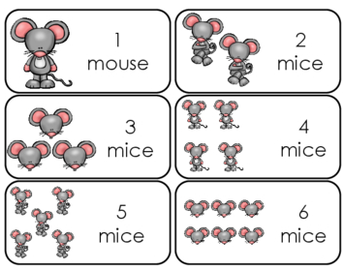
Transfers
&
Animal Counting
Transferring animals
  Location
  Protocols
  Principle Investigator
  Submit animal transfer form to dlam@unthsc.edu
Breeding/Using pups
  Breeding must be approved by the IACUC
  Pups are counted when used for research
  Please record usage on the breeding form

Slide 18
Transporting Animals
Only animals in the conventional hallway can be transported to and from your lab freely
Animals housed in the barrier hallway may NOT be moved freely to and from the lab
  They must stay inside the barrier
  Once removed, they cannot return
Freight elevator used when transporting animals
  Unless it is out of service, then use the passenger elevator
  Unauthorized use of the passenger elevator can result in the loss of facility access or protocol suspension
Transport of live animals to and from CBH building can only be done by DLAM staff
  To request transport with 24 hours notice, submit an animal transfer form to dlam@unthsc.edu

Slide 19
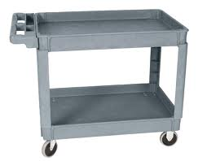
Transporting Animals
Must be transported in cages with a secure wire cage-top, micro-isolator top and a Tyvek cover
  This reduces stress of the animal(s) and reduces exposure of animal allergens to non-animal workers
  DO NOT cover cages with trash bags or yellow gowns
DLAM provides carts for use in the facility only
  Do NOT remove these carts for any reason
  Your lab must provide carts for transport to and from your lab

Slide 20
Transporting Animals
Housing outside vivarium
  Cannot be housed overnight (24 hours) unless it is approved in your protocol
  Animals found in your lab without authorization can result in loss of facility access privileges or protocol suspension
  If animals are housed overnight, they must have access to food and water and in a proper cage
  If animals are housed for 12 hours in your lab, their health needs to be assessed by a member of DLAM

Slide 21
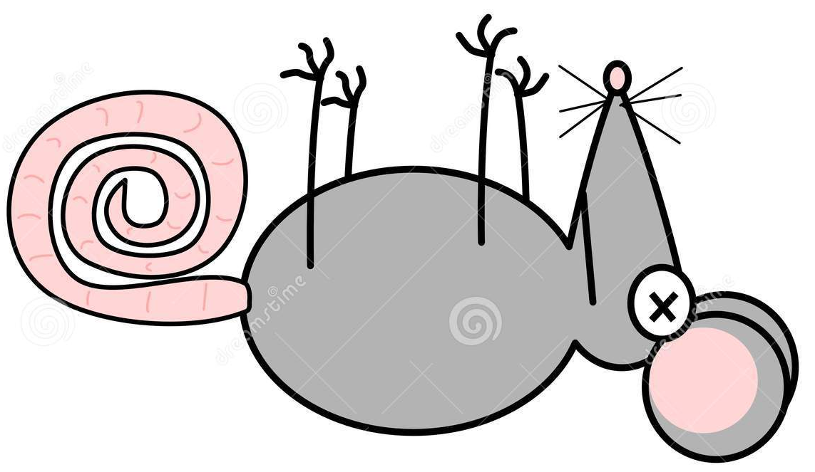
Euthanasia
Euthanasia methods
  Approved methods outlined by the American Veterinary Medical Association, and your protocol
  Any deviation can result in the loss of facility privileges or protocol
Examples of methods:
  CO2 asphyxiation (with secondary)
  Cervical dislocation (after CO2; alone requires proficiency)
  Barbiturate overdose

Slide 22
Euthanasia
Policies:
  Animal Euthanasia Form (aka Green sheet )
    West entrance to the facility
    Mark the cage card(s) with an “X”
    Turn the sheet in to a DLAM member
  Sacrificed animals in your lab
    Placed in a trash liner
    Hand to DLAM for disposal
    Please call x2014 to request a staff member to meet you at the carcass freezer on the dock

Slide 23
Euthanasia
Red biohazard bags NOT for regular disposal
CO₂ tank in the Necropsy room for use
  Ask DLAM staff to open the door
  Document in the log book in the room that you euthanized animals
PI will assure staff listed on protocol(s) are properly trained on euthanasia procedures

Slide 24
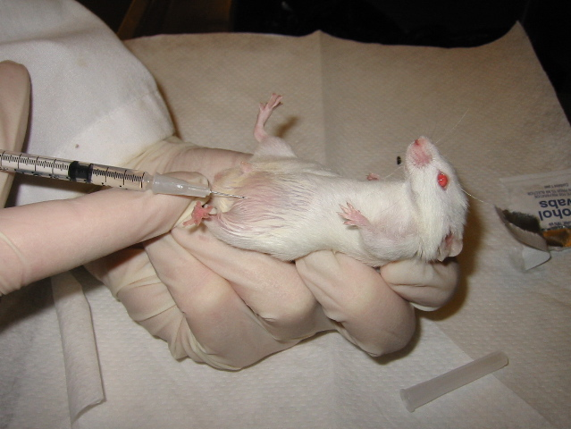
Procedures on Animals
Procedures will be taught by your lab
DLAM training available for:
  Surgical, injection, blood and tissue collection techniques
  Contact Tito, x 0590 for more information and scheduling
Reminders:
  Always follow the protocol
  Seek assistance

Slide 25
Surgery
DLAM’s surgery training is mandatory if surgery is listed on your protocol
  Polices
  Overview of aseptic technique
Not doing surgery now but will do so in the future?

Slide 26
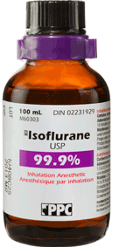
Anesthesia
Anesthesia may be used for procedures other than surgery
  Isoflurane – animals wake up rapidly
  Injectable anesthetics – animals take longer to wake; animals must be kept warm and lab staff MUST stay with animals until awake
Surgery/Post-op Record stays in animal room binder

Slide 27
Working with Animals in the Lab
Follow the same procedures as you would in the vivarium – lab coat, gloves, etc.
Keep your lab clean: No food or drink
Keep your lab locked at all times, especially when animals are present
No animals should be left unattended
If animals are recovering in the lab, cover the cage in case of a non-animal worker were to enter the room
A cleaning log must be kept in the lab to maintain a record when the lab and equipment the animals come in contact with was last sanitized
The same goes for procedural rooms inside the vivarium

Slide 28
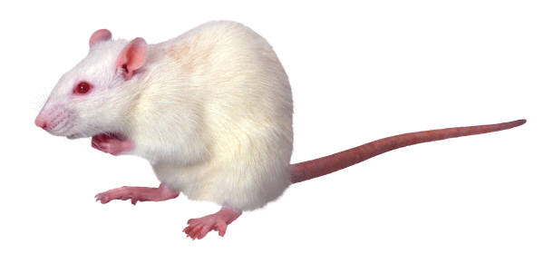
Concerns with Animal Care and Welfare
If you have any concerns or questions dealing with the care, use or handling of the animals in the vivarium, please bring it to the attention to any of the following:
  Dr. Daniels
  IACUC
  Ethics Line
  Marcie Dorsett
Your name will be kept confidential

Slide 29
Protocol Reminders
Read and understand the protocol
Animals can be ordered only on approved protocols
You must be listed on a protocol to do procedures on the protocol
Do not do procedures or use drugs that are not on the protocol
Amendment can be filed by PI with the IACUC office
Once approved, you can start a new procedure or use a new drug

Slide 30
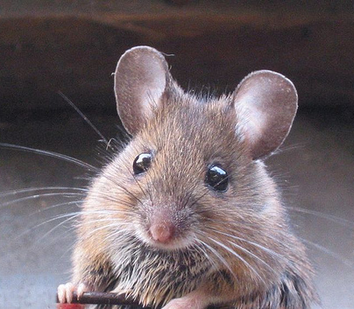
Thank you!
Remember - be nice to the mice…and other critters!

