Slide 1
Asset Processing
Mike Castillo Director of Central Services

Slide 2
Property Control Asset Processing
Purpose for Identifying Assets
Tracking for Inventory Purposes
Spot Check Inventories (Target Assets)
Annual Inventory (All Assets)
Reporting to State Property Accounting (SPA)
Monthly (Additions, Adjustments and Disposals)
Annual Financial Report Certification (Reconciliation) of SPA Balances (Capital Assets)
Annual Financial Report Note 2
Depreciation
Annual Inventory Certification

Slide 3
Property Control Asset Processing
Key Information for Property Control to Identify Assets
Purchasing Information. (Physical Data)
Asset Profile
EIS Alternate Account (Comptroller Object Codes)
Description
Purchase Value
Purchase Dept ID
Capital/Controlled Indicators
Life of Asset
Voucher Information. (Financial Data)
Amount Paid to Vendor
Voucher (Invoice) Date
Voucher Posting Date

Slide 4
Property Control Asset Processing
Processing the Asset
Combine Physical and Financial data through the EIS Asset Management Pre - Interface run control.
Move the data to the Asset Management Consolidation run control for multiple asset lines on a Purchase Order.
Group the physical and financial data lines by tag number and move to the Asset Management Transaction Loader.
Enter the accountability Dept ID in Asset Management.
Process a Property Acquisition Notice for review by the department for location, description, and serial number confirmation.
Enter in EIS Asset Management the location and any changes on the Property Acquisition Notice submitted by the department.

Slide 5
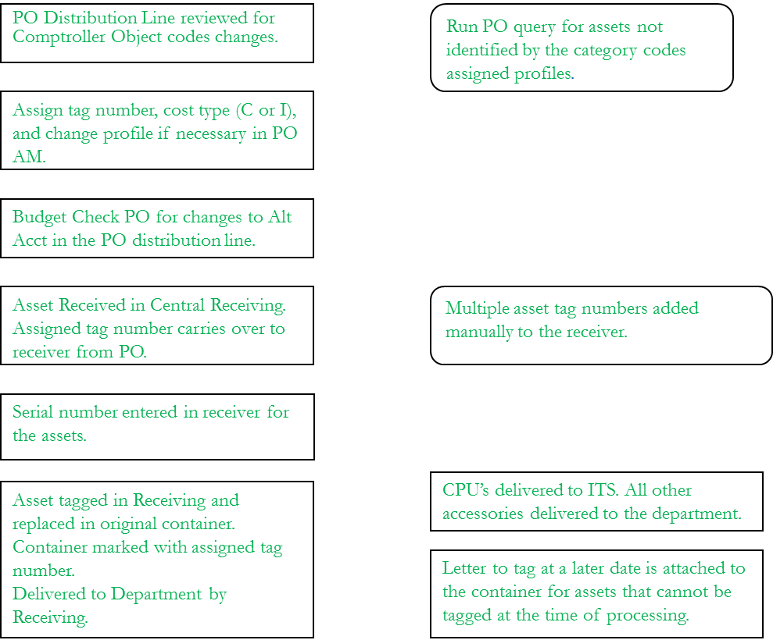
Property Control Asset Processing

Slide 6
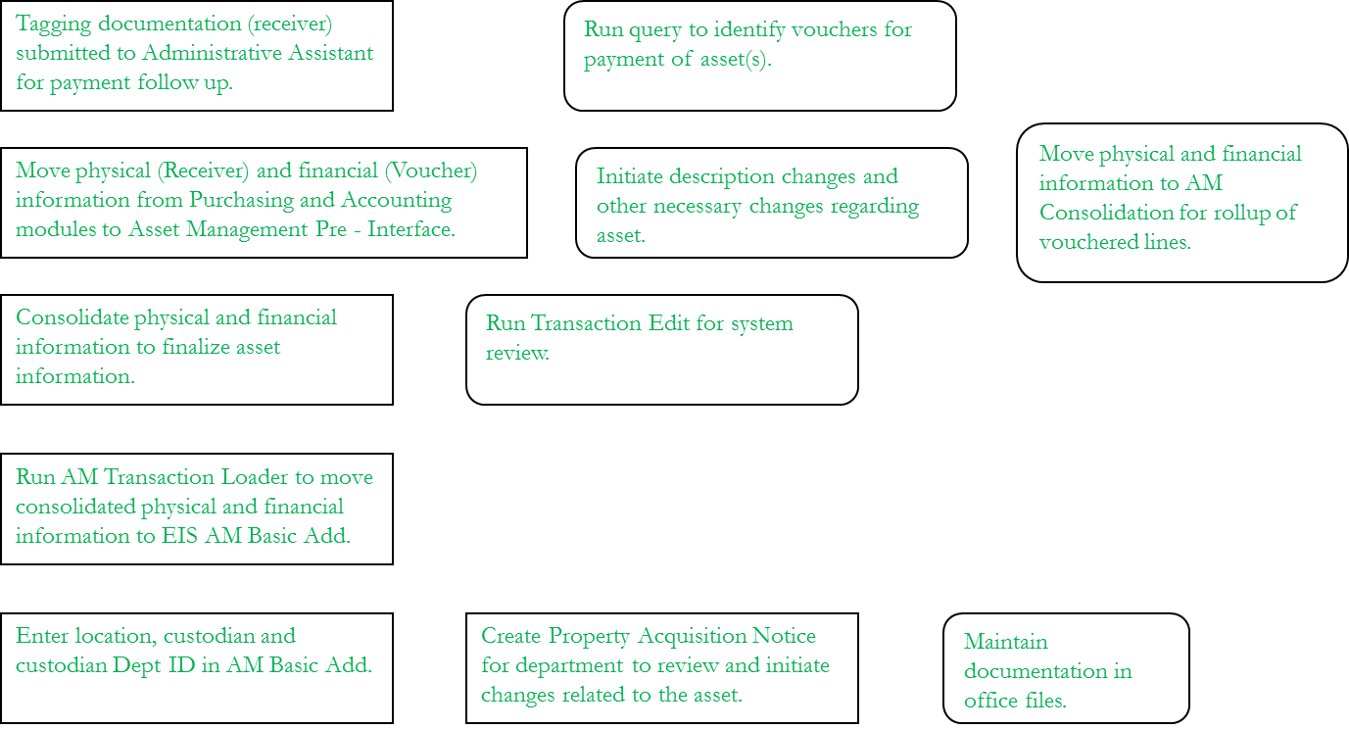
Property Control Asset Processing

