Slide 1
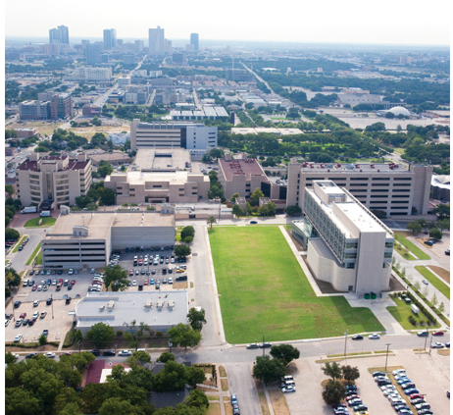
Financial Aid Office Making Education Possible
SSC 150

Slide 2
WHEN WILL I BE AWARDED
Be sure to complete the 2021-2022 FAFSA
(will cover summer 2021/fall 2021/spring 2022)
Every year, we expect to import new FAFSA data for the upcoming aid year in late April/early May.
Initial award notices go out in early/mid-May.

Slide 3
TYPES OF AID
Scholarships
General Scholarship Application (December-March)
Check website for updated outside opportunities
Grants
Determined by FAFSA submission date and EFC
Work Study
Available to students that have room in budget
Your responsibility to find a job (website, department, etc.)
Loans

Slide 4
LOAN INFO
Unsubsidized Loans—4.30% fixed interest rate
Federal Loan fees from each disbursement of 1.057%.
We can only award up to your cost of attendance (COA) per year.
ALL AID will be split evenly among your terms each year. If you attend fall/spring it’s split in half; summer/fall/spring it’s split into 3rds.
Check our website for other loan options if not awarded up to COA
PLAN AHEAD FOR EXTRA EXPENSES BETWEEN TERMS!!

Slide 5
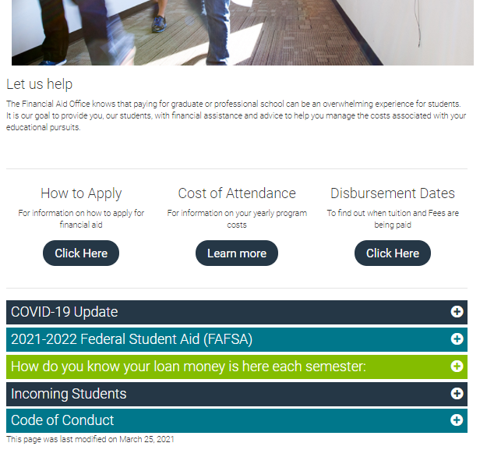
ONLINE RESOURCES
Our homepage: we post important updates here and the most looked for information

Slide 6
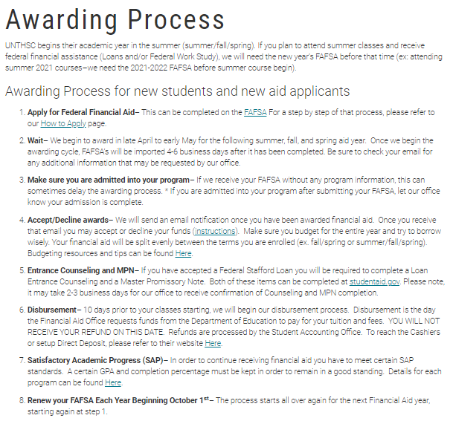
ONLINE RESOURCES
This is a quick step by step to go over the Financial Aid process for incoming students.

Slide 7
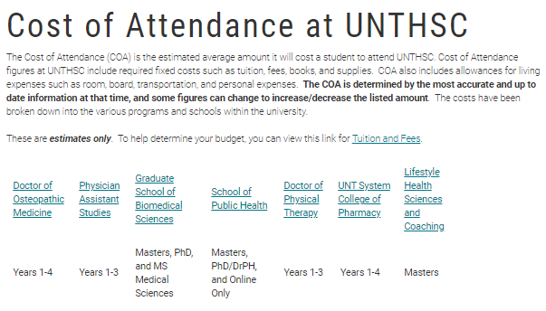
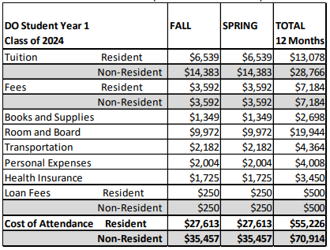
ONLINE RESOURCES
Each program is given a Cost of Attendance for the year. This includes tuition, fees, along with other expenses (see chart to the right). Numbers for 2021-2022 will be updated in April/May 2021, but you can use the 2020-2021 cost as an estimate for now.

Slide 8
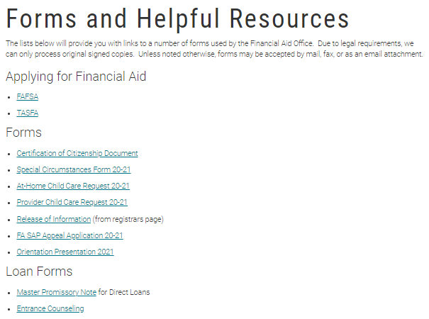
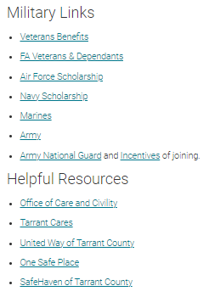
ONLINE RESOURCES
This page contains all the links and forms you need in one place.
We also have military links as well as other helpful county/city related resources.

Slide 9
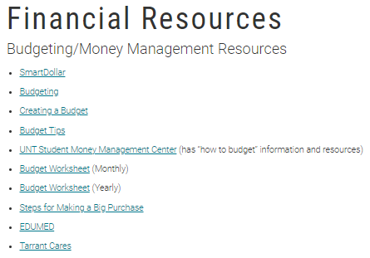
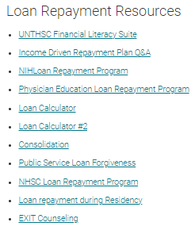
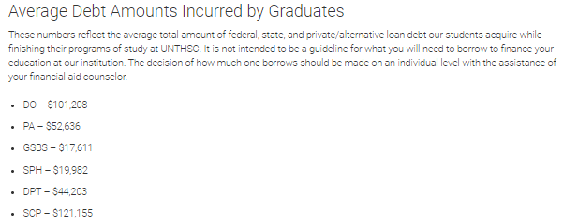
ONLINE RESOURCES
This page contains all financial resources in one place
We also have military links as well as other helpful county/city related resources.

Slide 10
WHERE TO GET INFO
Student Portal – Online
Tuition and fees owed – your bill
Financial aid awarded
Holds – What they are and how to remove them
Registrar’s Office
Enrollment
Verification of enrollment
Deferment for prior loans
Health Insurance info
Financial Aid Office
Verification of financial aid award
Applying for scholarships or loans
Disbursements
Student Financials Office
Actual tuition and fee charges
Refund questions
Click on the name of each to be taken to their website

Slide 11
STAYING CONNECTED
Familiarize yourself with our website
http://www.unthsc.edu/financial-aid
Read your e-mails
Primary form of contact with you
The subject line will have: UNTHSC Financial Aid:
Add our email address to your “safe list” so it does not filter into junk/spam folder
finaid@unthsc.edu
scholarships@unthsc.edu
Phone# 817-735-2626
Fax# 817-735-0448
Twitter: @UNTHSCFinaid
Speak with a Financial Aid Counselor through LIVE CHAT on our website

Slide 12
QUESTIONS
If you have a mortgage and children and the federal loan amount is not enough for living expenses, can it be adjusted?
Is the FAFSA grad plus loan something that students take in order to pay for their education or is FAFSA typically enough? Particularly for Texas residents
What’s the best way to budget money so one can pay off loans in most efficient manner?

Slide 13
QUESTIONS
Are there any financial need-based scholarships available and will they be renewed each year? How are scholarships applied to students accounts?
When can I start speaking to someone about financial aid?
Are you able to return any amount that is not used from a loan borrowed?

Slide 14
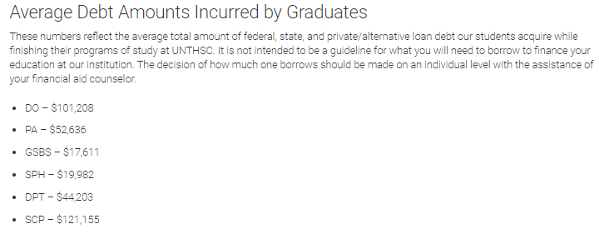
QUESTIONS
What is the average debt that students graduate with?

