Slide 1
MHA Internships 2013

Slide 2


Kent Palamore
Preceptor: Terri Nuss, MS, MBA, VP of Patient Centeredness
Major Project:
Noise Project
Reviewed data to identify the root cause of noise-related complaints
Compared units with high PG and HCAHPS scores to units with low scores and determine key differences
Developed potential intervention and implementation strategies that can be applied to a pilot site
Be able to apply findings to other across the system
Develop a leader’s diagnostic toolkit
  Identify opportunities for improvement
  System to prioritize which sources they should address first

Slide 3
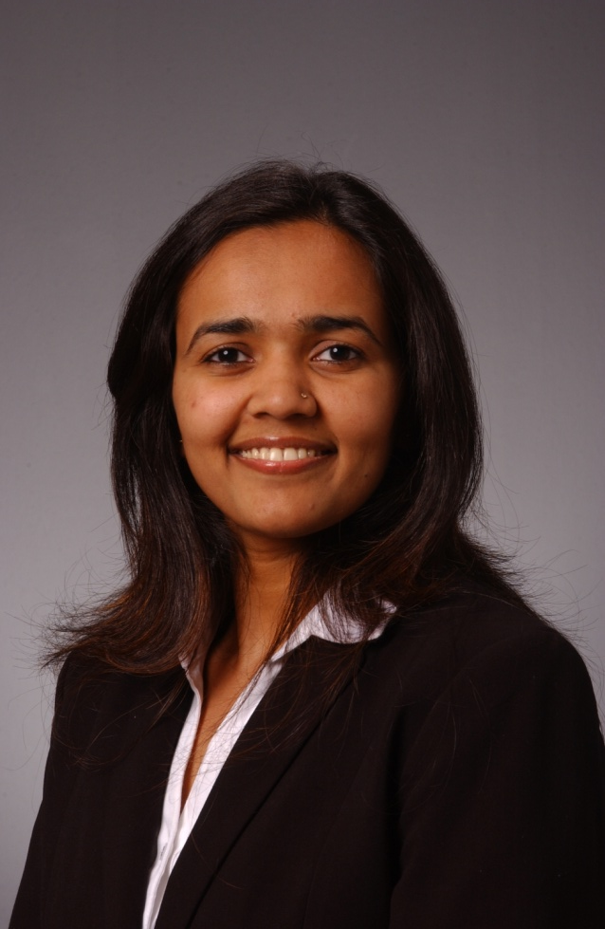

Shilpa Chhadwa
Preceptor: Jim Walton, DO, MBA, President & CEO
Major Projects:
Development of GAPN ACO
ACO Coordinator
  Researched the requirements and developmental needs related to ACO approval by CMS
  Development of a new LLC and its related agreements/contracts
  Development of job descriptions for the LLC
  Development of the organizational governance and management structure
  Developed the overall ACO Project structure
  Attended strategy, IT, Development, Recruitment and Care Coordination staff meetings
  Ensured that all application deadlines for ACO approval are met
  Budget analysis
  Supported the Genesis ACO Membership Recruitment & Support staff during both the recruitment and operational phases of the ACO
  Supported the Genesis ACO Care Coordination staff in the development of the Care Coordination Software and operations
  Supported the Genesis ACO Health IT staff in the development and operations of the ACO IT activities

Slide 4
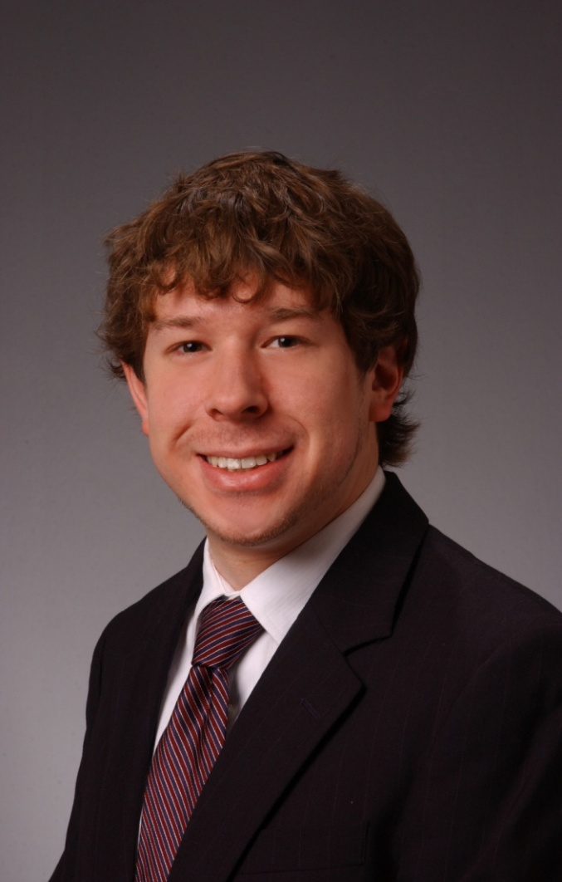

Garrett Boland
Preceptor: John Christensen, Senior Analyst
Major Projects:
Ad Hoc Reporting
  Patient targeting in Walgreen’s hospitals
  Late patient eligibility reports
  Improving patient targeting reports
CCTP - PAC (Community Based Care Transitions Program – Post Acute Care)Transfer Survey follow-up calls
Completed various PDF forms for Loopback Navigator and INTERACT (Interventions to Reduce Acute Care Transfers)
Help desk support

Slide 5
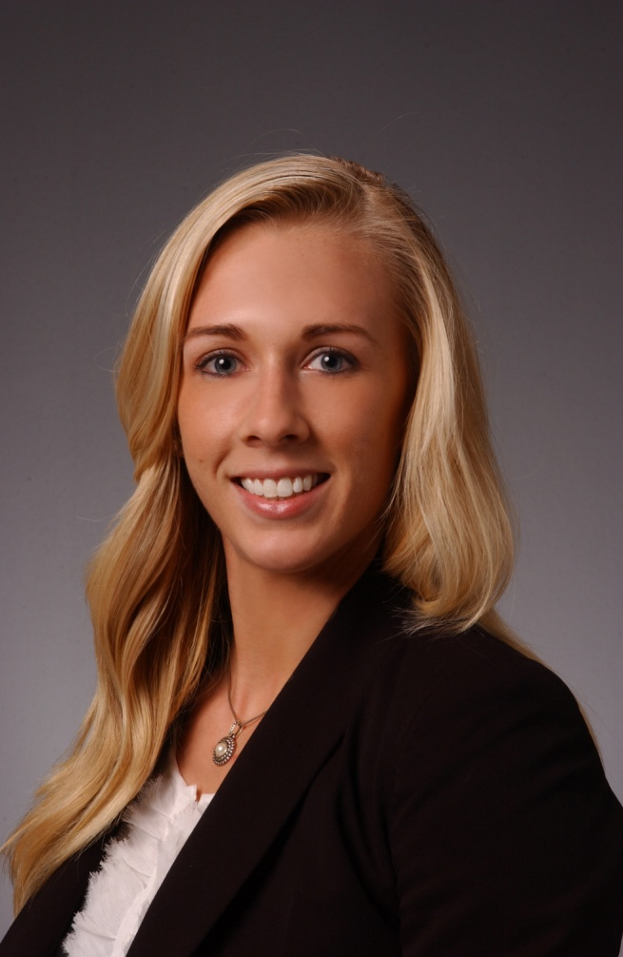
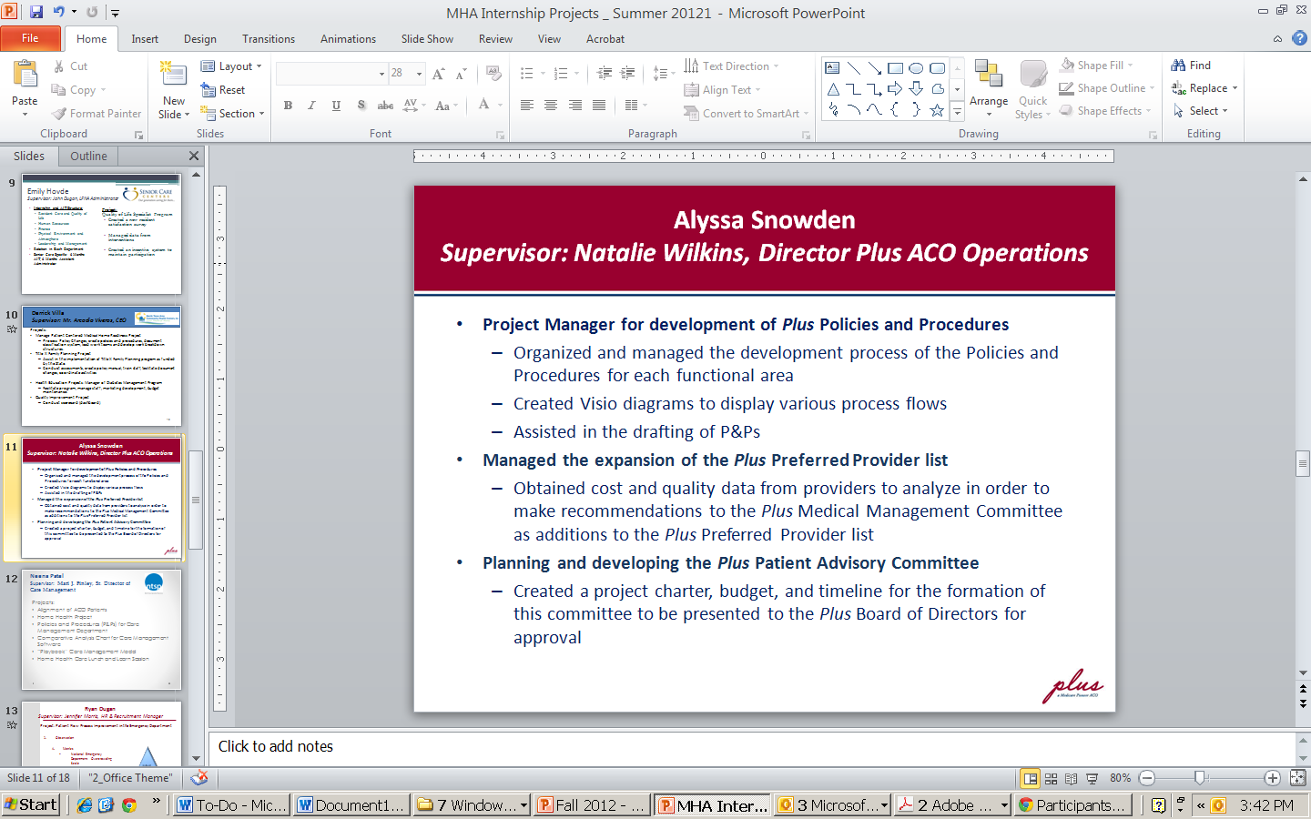
Karyssa Bowers
Preceptor: Natalie Wilkins, Plus ACO-Director
Major Projects:
Weighted Ranking Project
Preferred Provider Process
  Applicant Provider Process
  Alignment of ACO patients
  Preferred Provider Executive Packet
  Geographic Barrier Project
  Quality Data Tracking (CASPER, ERehab, UDS, Hospice Compare, Deyta)
  Preferred Provider/ Applicant Provider Claims Reporting
  Hospital ECIN Reports
  Hospital Placement Reports

Slide 6
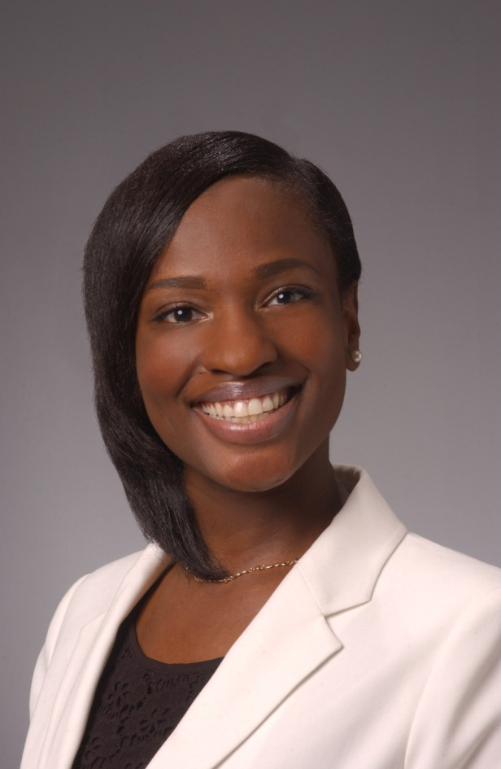
Alexis Hunter
Preceptor: Lewis Garrison, MSA, HSA, Med, Practice Operations Manager II
Major Projects:
Developed Fire Escape Plan for Compliance
Patient Registration Observation and Project Proposal: Front Office Success
Developed Electronic Floor Plan to Study Patient Flow
Scheduled Interviews for Non-Clinical & Clinical Candidates
  Active Involvement in Interviews
Accompanied Clinical Supervisor on Compliance Site Visit at BFMC Midlothian
Observed Management Meeting and Staff Meeting
Created Database for Medical Supply Inventory
Exposed to Accounts Payable Overview and Organization
  Audited and Reconciled Invoices for Financial Assurance
Audited Employee Time Entry (Baylor Attendance Policy)

Slide 7

Chelsea Hart
Preceptor: Joseph DeLeon, President
Major Projects:
Tier II Observations
  Employees observe other employees to ensure they are following the correct procedures of the hospital
  The specific procedures include
    Patient Identification
    Hand Hygiene
    Time Outs During Surgery
  Collected the data from employees and used this information to create spreadsheets providing analysis and conclusions
  Presented findings monthly to the executive team and to the Director of Quality Improvement, comparing them to previous months

Slide 8
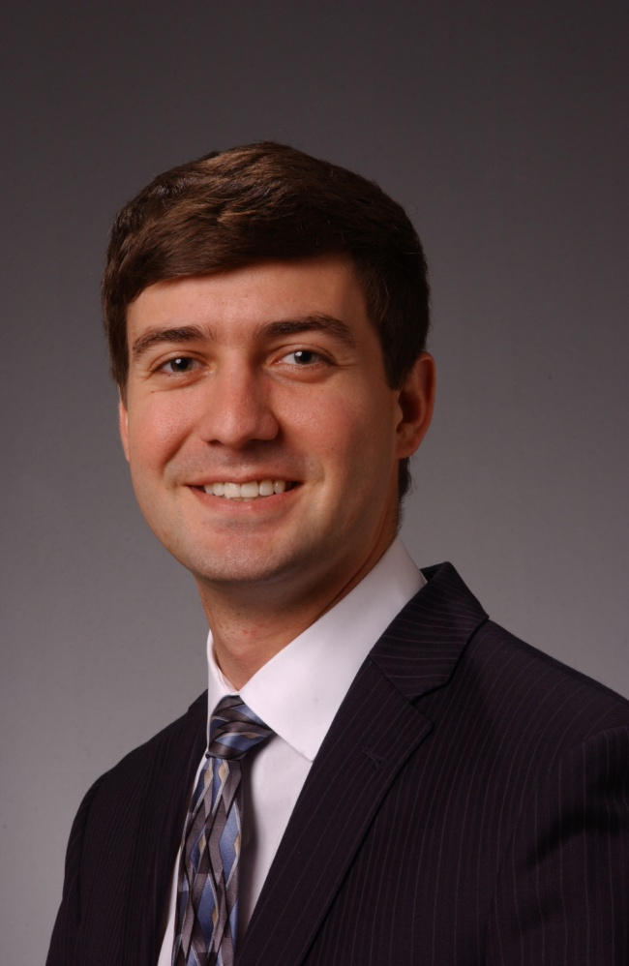
Matthew Stabe
Preceptor: Terri Nuss, MS, MBA, VP of Patient Centeredness
Major Project:
HCAHPS Crisis Admissions
  Patients admitted through the ED are showing a decline in their experience year-to-year
  ED volumes are growing
  These growing volumes are having a negative effect on system HCAHPs scores
  From a service stand point, we have a duty to help these patients
  From a financial stand point, if this patient population continues to have a declining experience, reimbursements will be at risk due to a decrease in Value-Based Purchasing

Slide 9
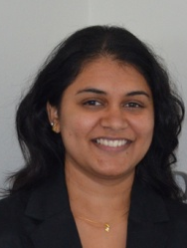

SriLakshmi Gummadi
Preceptor: Dr. Elizabeth Trevino, CEO
Major Projects:
Needs Assessment Report
  Patient origin by Zip Code
  Uninsured, Infant Mortality rate, Health Professional Shortage Areas, etc
JPS Community Connect Project
  Partnership with JPS Health Network for one of Medicaid Waiver Project
  Completed the Partner Capability Summary
Employee Hand Book
  Reviewed, updated and added recent approved policies
  Formatted the new handbook – distributed to all employees July 2013
Data Reports
  Diabetes Salud! Program
  NTACHC Patient Satisfaction Surveys
Organized and Restructured NTACHC Policies
  Assisted with the development and implementation of NTACHC Policy Library
Assisted with HRSA Operational Site Visit
  Collected and compiled operational, financial, clinical, compliance, patient and board governance documents to ensure compliance for FQHC requirements
Participation in various meetings
Texas Vaccines For Children (TVFC) Program
  Understand the policies and Procedures

Slide 10


