Slide 1
Student Accounting

Slide 2
Student Accounting
 Monday – Friday
 8:00 a.m. – 5:00 p.m.
 Fax: (817) 735-0677
 StudentFin@unthsc.edu
 Website:
www.hsc.unt.edu/departments/ofpb/sfcs/

Slide 3
Student Accounting
Student Accounts Cashiers Office
Jo Nell Cates, Principal Accountant Peggy Jacobs, Accounting Analyst II
 SSC 158  817-735-2667  SSC 159  817-735-2534
Emily Vixay, Accounting Analyst Thresia Taylor, Accounting Analyst II
 SSC 150-B  817-735-0676  SSC 159  817-735-2534
Sameh Alami, Accountant
 SSC 150-A  817-735-2026
Loans and Collections Refunds (in Denton)
Jessica Phillips, Accounting Analyst III Courtney Potts, Accountant
 SSC 150-C  817-735-2548  940-565-3226

Slide 4
Student Accounting
Tuition and Fee Charges
Electronic only on Student Center
Additional charges may result from changes in enrollment during add/drop. Check your student center.
Tuition and Fee Payments
Payment deadline is the day before the class starts
Bill payment at the Cashier’s office by cash or check only
Online bill payment with credit or debit card – 2.7% fee
Installment Payment Plans available for Fall and Spring Only
International wire transfers – Bank information in Student Accounting
Flywire Peer Transfer for international payments using foreign currency

Slide 5
Student Accounting
Process Exemptions and Waivers
Employment Waivers
Competitive Scholarship Waivers
President’s Educational Scholarship
Hazlewood
www.collegeforalltexans.com
Third Party Billing
Military billing
National Health Service Corps
Texas Tomorrow Fund
Tax Information
1098-T information online via self service

Slide 6
Student Accounting Refunds
Once your Financial Aid is disbursed, we will process your refund:
the next business day if it is the first disbursement of the term
on either Tuesday or Thursday for the rest of the term
You may receive your refund via:
Paper Check to pick up in Cashiers Office (mailed after a week)
Direct Deposit into your bank account
You may sign up for Direct Deposit on your MyHSC Student Center

Slide 7
CONTACT INFO
Registrar’s Office
registrar@unthsc.edu
P:(817) 735-2201
F:(817) 735-0448
Financial Aid Office
finaid@unthsc.edu
P:(817) 735-2505
F:(817) 735-0448
Student Finance
StudentFin@unthsc.edu
P:(817) 735-2026
P:(817) 735-0676
F:(817) 735-0677

Slide 8
Student Accounting
CONTACT INFORMATION
Jessica Phillips Email: Jessica.Phillips@untsystem.edu
Phone: 817-735-2548 Fax: 817-735-0677
Heartland ECSI
Website: www.heartlandecsi.com
Phone: 800-437-6931
Address: 100 Global View Drive
Warrendale, PA 15086

Slide 9
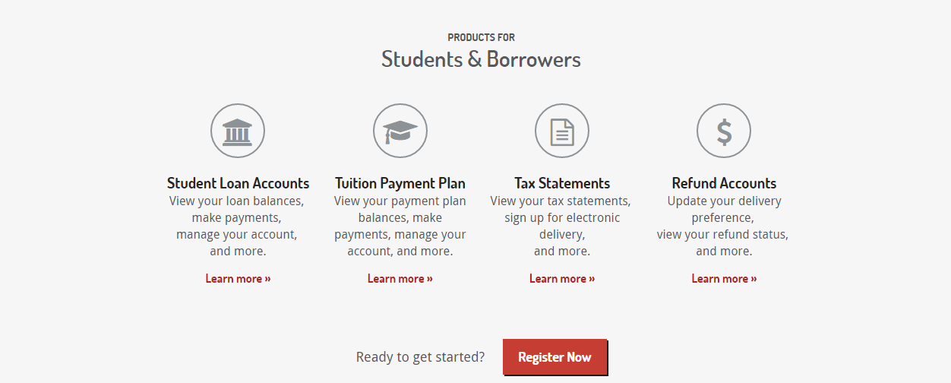
Student Accounting
ACCOUNT SERVICER
Heartland ECSI
https://heartland.ecsi.net/
Create A username and password
School Code: Wi5
Account Number: SS#
Passcode – Has to be obtained thru ECSI

Slide 10
Student Accounting
MAKE SURE YOUR CONTACT INFORMATION IS UP TO DATE
It is vital that your information with the school stays up to date.
Mailing Address Email Address Phone Number
Current Students – Update information on your Student Center
Graduates - Update information with Alumni Association
or Registrar

Slide 11
Questions?

