Slide 1
Student Finance & Cashiering Services

Slide 2
Student Finance
Tiffinie Jones, Director
 SSC 158
Michele Duncan-Grays, ERP Functional Accountant
 SSC 150
Yolanda Sparks, Accounting Analyst II – Billing / Waivers / Customer Service
 SSC 150  817-735-2026
Peggy Jacobs, Accounting Analyst II – Third Party
 SSC 150  817-735-0676
Thresia Taylor, Cashier – Customer Service
 SSC 159  817-735-2534
Collections Coordinator – Vacant
 SSC 150 
Notes:
We are positioned within the student service center in Suite 150

Slide 3
How We Can Help
Tuition and Fee Charges
No paper bills – View your account through your student portal MyHSC
Payment Deadline Is The Day Before Class Starts
A $15 late payment fee will be charged for any payment received after the due date. Additional late fee(s) will be assessed each month for past due balances.
Changes in enrollment during add/drop may result in additional charges being due.
Tuition and Fee Payments
Online payments with credit card, debit card or E-Check
Payments at the Cashier’s Office by cash, check, cashiers check, or money order.
Installment Payment Plans available for Fall and Spring only
Flywire (Company) - for international payments using foreign currency
Refunds
Electronic Refunds – Direct Deposit enrollment required to participate
Paper checks will be mailed if not picked up within 7 days
Notes:
** After first bullet section ** So, please ensure that you keep a watch out for your HSC email account, as this is where communication will be carried out.

Slide 4
How We Can Help
Process Exemptions and Waivers
Out-of-State Residency Waivers
Competitive Scholarship Waivers
President’s Educational Waiver
VA –Hazlewood, Chapter 33, Chapter 31
Third Party Billing
Military billing
National Health Service Corps
Texas Tomorrow Fund
Saudi Arabia Cultural Mission (SACM)
Tax Information
1098-T information online via self service
Past Due Account
Notes:
Larrie
Mary

Slide 5
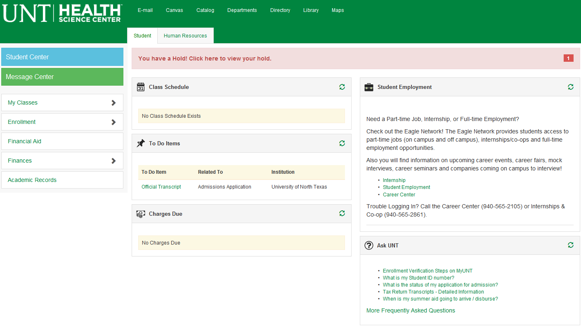
Student Center
Click on ‘Student Center’
Notes:
Once you have used your login credentials the next screen will show the following information, information can be viewed under each icon; however, you would want to click on the student center icon to view your detailed account information.

Slide 6
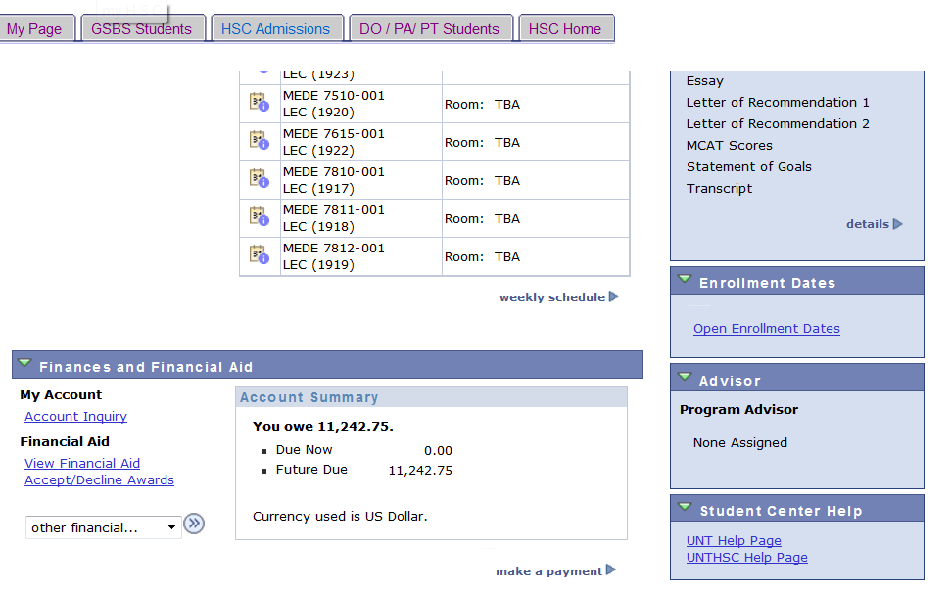
Account Inquiry/Make a Payment
Account Inquiry
Make a Payment

Slide 7
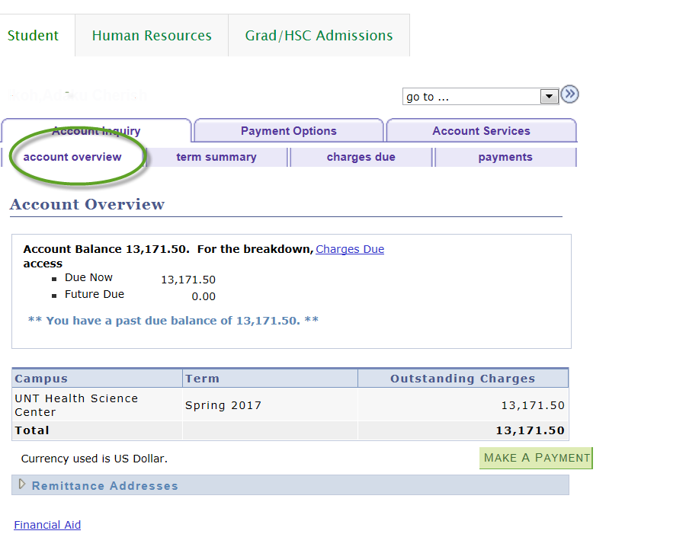
Account Balance

Slide 8
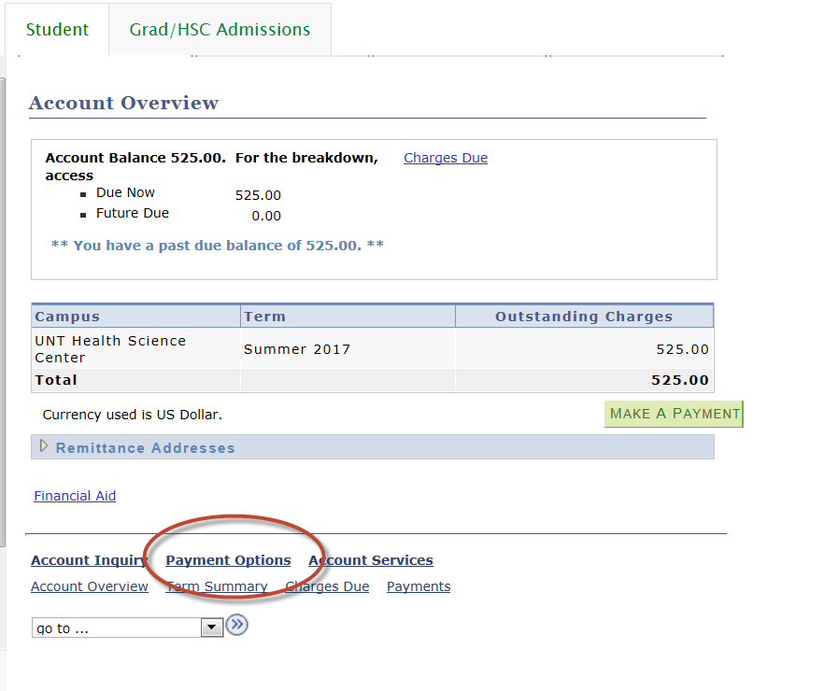
Installment Plans
Notes:
To reiterate, Student Finance offers payment plans during the Spring and Fall Terms only. To sign up for an installment or payment plan, this information is also available under your student center

Slide 9
Forms
Short Term Loans
Emergency Loan Application
Out of State Residency Waiver
President’s Educational Waiver
Notes:
Also, additional information pertaining to what forms of payment are received as well as the detailed information regarding payment plans are all available through the Student Accounting and Cashiering Services tab on UNTHSC’s website. So.. from the UNTHSC homepage click within the search field and type Student Accounting Forms, to view additional information regarding Student Accounting services.

Slide 10
Refunds
After your Financial Aid is disbursed, Student Finance will process refunds 10 days prior to start of classes.
Refunds are normally processed on Tuesdays and Thursdays.
You may receive your refund via:
Paper Check
Direct Deposit into your bank account
You may sign up for Direct Deposit on your MyHSC Student Center
Notes:
** 3rd bullet ** There are two options for you to receive your refund, rather …

Slide 11
Signing up for Direct Deposit
On your Student Center,
Click on the Account Inquiry Link under “My Account”.
Click on Account Inquiry

Slide 12
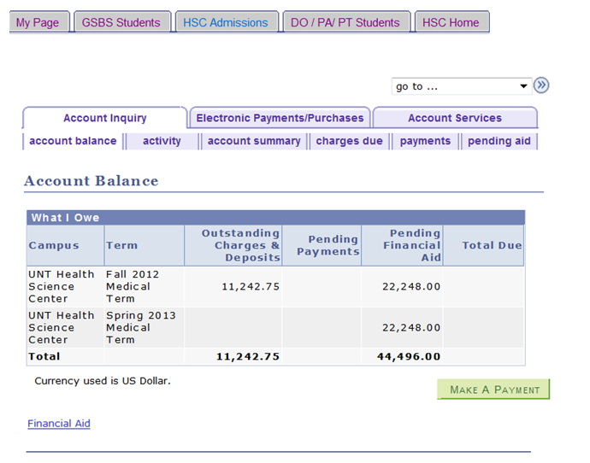
Signing up for Direct Deposit
Click on the Account Services tab to get to the Direct Deposit Enrollment.

Slide 13
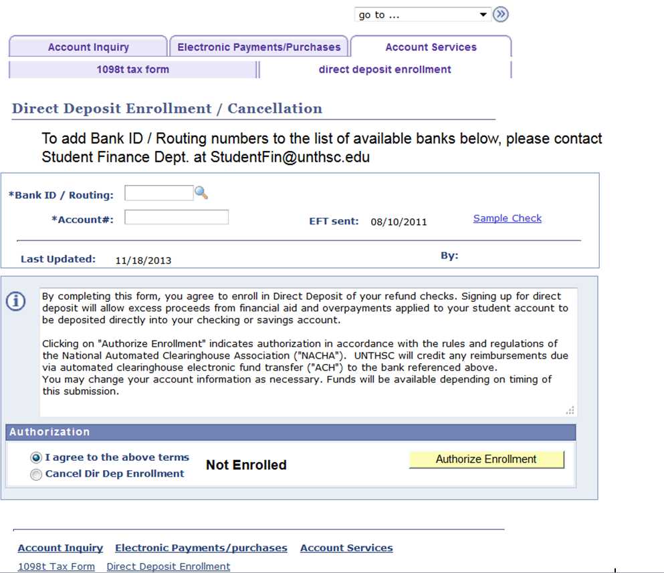
Signing up for Direct Deposit
Enter the Bank ID/Routing and Account # and select “I agree” then click “Authorize Enrollment”.

Slide 14
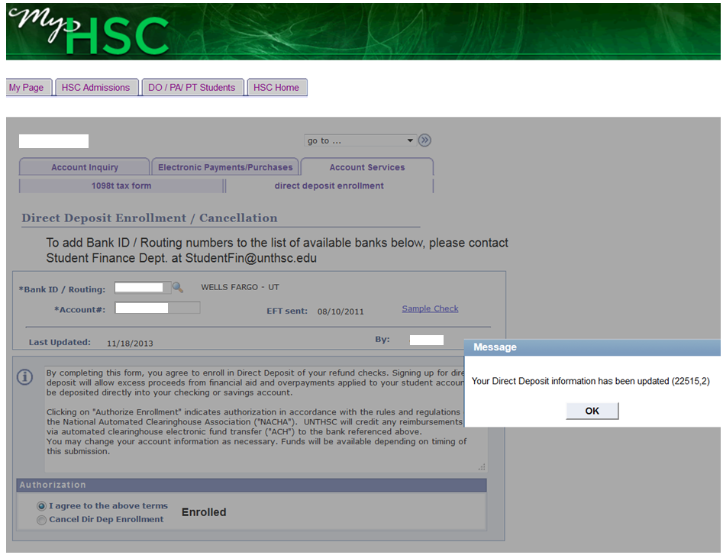
Once you have authorized enrollment you should get a verification message.
Doe, Jane
999999999
123456789
jad1234
Your direct deposit will then show
Enrolled.
Notes:
Also, please keep in mind that if you are not currently enrolled in any classes you will not be able to make any changes to your direct deposit information, until you are enrolled.

Slide 15
Questions?

Slide 16
Contact Information
 Monday – Friday
 8:00 – 5:00 pm
 817 -735 -2026
 StudentFin@unthsc.edu
 Website:
www.hsc.unt.edu/
Notes:
This is an overview of the Student Accounting Department, but if for any reason you need to speak to someone in person … our office hours are from ** Slide**
**Next Slide***

Slide 17
Make Sure Your Contact Information Is Up To Date
It is vital that your information with the school stays up to date.
Mailing Address Email Address Phone Number
Current Students – Update information on your Student Center
Graduates - Update information with Alumni Association
or Registrar
All official school communication is sent to your unthsc.edu email. It is your responsibility to check this. Remember you can forward unthsc.edu email to your personal email.
Notes:
As times will become busy for you during your years of study, we would like to reiterate how important it is to ensure that your … *** Slide ***

